Slide 1

ONSTR/NBSDC Meeting
October, 21st 2013

Slide 2

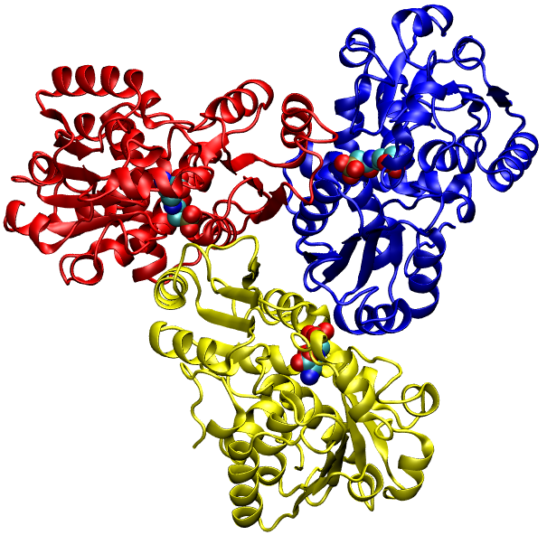
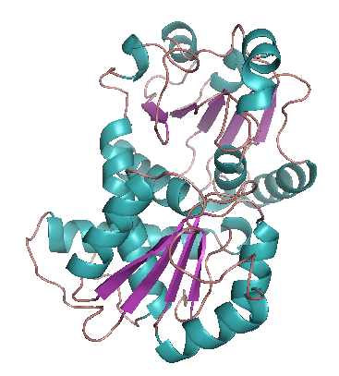
Inherited Metabolic Diseases (IMDs)
46 of 57 diseases screened through the US NBSS
Etiology
Enzyme protomer
gene mutation
Misfolded or missing
enzyme protomer
Dysfunctional or missing
enzyme complex
Toxic accumulation
of enzyme substrate
and other metabolic
byproducts
Lack of enzyme
Product
CNS malnurishment
and damage
Developmental delay
(psycho-
motor-cognitive)
LTFU: Life-long (Primarily) Nutritional Treatment
and Patient’s Growth and Development Monitoring
Restrict the dietary intakes of foods containing
the enzyme substrate (e.g., target amino/fatty/organic acid)
2. Maintain the adequate intakes of all other nutrients
to ensure maximally normal growth and development
3. Continuously adjust/improve treatment based on the patient’s growth

Slide 3
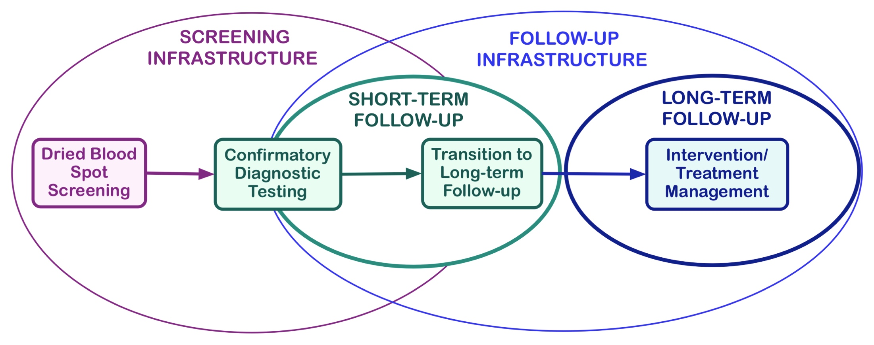
The Data
Screening Data
DBS screening results
Gestational age
Birth weight/height
STFU Data
Confirmatory test results
Genetic mutation info
LTFU Data
Dietary intakes
Metabolite concentrations
Full blood count
Anthropometric measurements
Body composition, Bone density
Imaging data (MRI, EEG, CT, Xray)
Psycho-cognitive-motor assessments
Clinical history, Neurotransmitter levels
• Continuous Quality Improvement of Patient Treatment and Outcome
• Translational Research (Generates more data)
• New Knowledge Generation and Meaningful Use

Slide 4
LTFU Patient Visit and/or Research Participant Visit*
Patient/Research Study Participant provides the filled Dietary Intake Record
containing the information about all food items ingested by
patient/participant during certain time interval (3-Day, 2-Day, 1-Day, 24hours)
Dietitian uses nutrient analysis software, enters the food item data
Nutrient analysis software (MetabolicPro, NDSR, FoodProcessor)
produces average daily nutrient intake data
(grand averages of all ingested nutrients taken in 3-Day, 2-Day, 1-Day, 24hours)
Dietitian/Researcher uses these average daily nutrient intake data
1. to monitor/control the intakes of the target nutrient (amino/fatty/organic acid)
2. to determine whether the intakes of nutrients are sufficient for normal
body growth and development
3. to analyze them wrt to blood concentrations of the target nutrient(s)
4. analyzes them wrt to anthropometric measurement (height, body mass, head
circumference, BMI, bone density)
5. to adjust or change/improve the existing nutritional diagnosis and/or therapy
in order to ensure normal patient’s growth and development
* Noun phrases set in italics and in different font color correspond to classes asserted in the ONSTR.
Note: Actual ONSTR class names may differ (more or less) in wording from the actual class names.

Slide 5
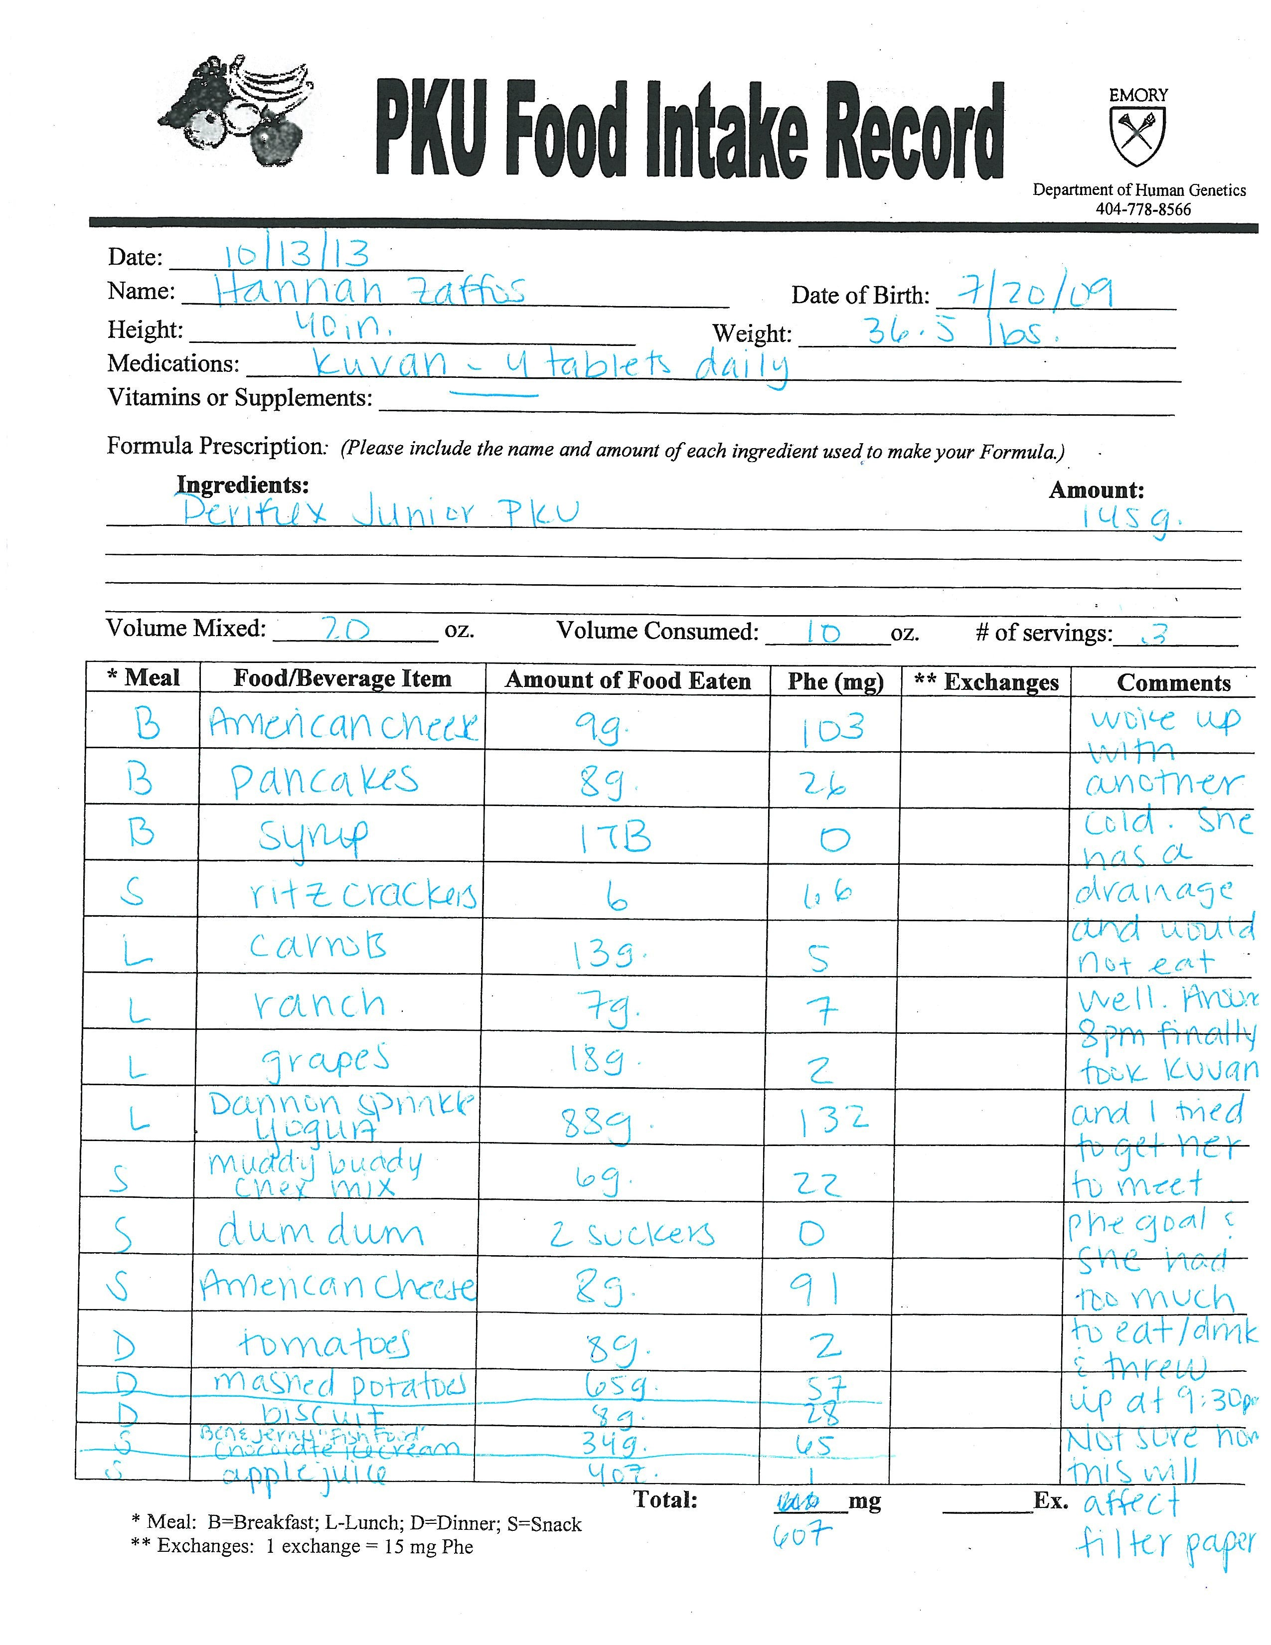
Data source: Nutritional item intake record (a.k.a. diet record)

Slide 6
Raw data: Nutrient intake summary report

Slide 7
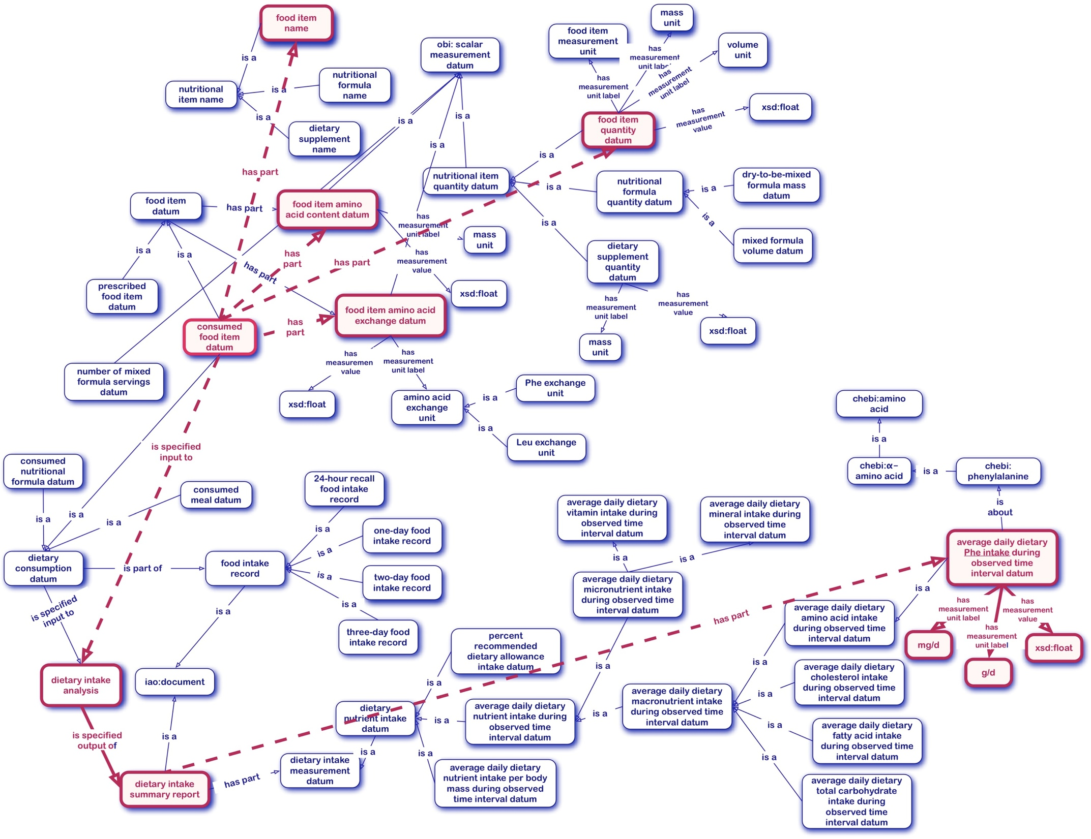
ONSTR graph – Dietary analysis (SERC 2012, old pre-BFO2 graph!)

Slide 8
What a Dietitian/Researcher needs/wants to know:
1. Is each average daily nutrient intake value wrt Dietary Reference Intake values (DRIs): low, high or in normal range
2. What percent of a Dietary Reference Intake value is particular value of the average daily nutrient intake, e.g., 25% of DRI (low intake), 125%DRI (high intake)
3. What kind of diet record is the source of consumed food item data (7,3,2,1-Day record, or 24h recall record)
4. Which nutrient analysis software produced the given average daily nutrient intake, because there are differences in values in the intake data produced by different (MetabolicPro, NDSR or FoodProcessor)

Slide 9

DRIs: Dietary Reference Intake values
Dietary Reference Intakes: The Essential Guide to Nutrient Requirements (Dietary Reference Intakes Series).
Otten, J. J., Pitzi Hellwig, J., Meyers, L. D. Eds (2006) Dietary The National Academies Press, Washington DC
To determine if the nutrient intake value is low/high/normal wrt DRIs we need to know:
1. age (at LTFU/research study visit)
2. phenotypic sex (datum)
3. state wrt pregnancy and lactation
4. nutrient intake value
5. measurement unit
Based on 1-3 only: app 11 different groups
Additionally:
6. type of diet record that is the source of consumed food item data
7. which nutrient analysis software produced the nutrient intake value

Slide 10
DRIs: Dietary Reference Intake values - Minerals

Slide 11
Similar Scenarios
Average daily nutrient intake
1. age (at LTFU/research study visit)
2. phenotypic sex datum
3. state wrt pregnancy and lactation
4. measurement value
5. measurement unit
6. source diet record info
7. nutrient analysis software info
Blood chemical concentrations
and cell count
1. age (at LTFU/research study visit)
2. phenotypic sex datum
3. state wrt pregnancy and lactation
4. measurement value
5. measurement unit(s)
6. analytical method
Developmental Growth Indicator (a.k.a. Growth percentile)
1. age (at LTFU/research study visit)
2. phenotypic sex datum
3. height/weigh/HC/BMI measurement value(s)
4. measurement unit(s)

Slide 12
Ontology - Classes

Slide 13
Ontology - Relations
has informational basis
A IAO:data item is obtained based on IAO:information content entity or IAO:data item or items.
Skipping the OBI:data transformation process and IAO:is specified output of OBI:planned process
is datum produced by
A IAO:data item is produced by he execution of some nutrient analysis software
has alphanumerical value
Used for all string (non-computable) values e.g., phenotypic sex datum values (F, f, M, m)
IAO relations
IAO:has measurement unit label
IAO:has measurement value

Slide 14
Ontology – Logical descriptions
high average daily dietary leucine intake per body mass (ONSTR_0440505)
'average daily dietary leucine intake per body mass during observed time interval'
and ((((((('has informational basis' some 'phenotypic sex datum’) and ('has informational basis' some
(('age at long-term follow-up interval visit measurement datum’ or 'age at research study visit measurement datum')
and ('has measurement unit label' some year) and ('has measurement value' some (float[>= 4.0f] and float[< 9.0f])))) or (('has informational basis' some ('phenotypic sex datum’ and ('has alphanumerical value' some ({"M"^^string , "m"^^string})))) and ('has informational basis' some (('age at long-term follow-up interval visit measurement datum’ or 'age at research study visit measurement datum’) and ('has measurement unit label' some year) and ('has measurement value' some (float[>= 9.0f] and float[< 14.0f])))))) and ('has measurement value' some float[> 49.0f]) or (((('has informational basis' some ('phenotypic sex datum’ and ('has alphanumerical value' some ({"F"^^string , "f"^^string}))))
and ('has informational basis' some (('age at long-term follow-up interval visit measurement datum’ or 'age at research study visit measurement datum’) and ('has measurement unit label' some year) and ('has measurement value' some (float[>= 9.0f] and float[< 14.0f])))))
or (('has informational basis' some ('phenotypic sex datum’ and ('has alphanumerical value' some ({"M"^^string , "m"^^string}))))
and ('has informational basis' some (('age at long-term follow-up interval visit measurement datum’ or 'age at research study visit measurement datum’) and ('has measurement unit label' some year) and ('has measurement value' some (float[>= 14.0f] and float[< 19.0f]))))))
and ('has measurement value' some float[> 47.0f])) or (((('has informational basis' some (('age at long-term follow-up interval visit measurement datum’ or 'age at research study visit measurement datum’) and ('has measurement unit label' some month) and ('has measurement value' some (float[>= 7.0f] and float[< 12.0f])))) and ('has measurement value' some float[> 93.0f])) or (('has informational basis' some (('age at long-term follow-up interval visit measurement datum’ or 'age at research study visit measurement datum’) and ('has measurement unit label' some month) and ('has measurement value' some float[< 7.0f]))) and ('has measurement value' some float[> 161.0f])) or (('has informational basis' some (('age at long-term follow-up interval visit measurement datum ’or 'age at research study visit measurement datum’) and ('has measurement unit label' some year) and ('has measurement value' some (float[>= 1.0f] and float[< 4.0f])))) and ('has measurement value' some float[> 63.0f])) or (('has informational basis' some (('age at long-term follow-up interval visit measurement datum’ or 'age at research study visit measurement datum’) and ('has measurement unit label' some year) and ('has measurement value' some (float[> 19.0f])))) and ('has measurement value' some float[> 42.0f]))) and ('has informational basis' some 'phenotypic sex datum')) or (('has informational basis' some ('phenotypic sex datum’and ('has alphanumerical value' some ({"F"^^string , "f"^^string})))) and ('has informational basis' some (('age at long-term follow-up interval visit measurement datum’ or 'age at research study visit measurement datum’) and ('has measurement unit label' some year) and ('has measurement value' some (float[>= 14.0f] and float[< 19.0f])))) and ('has measurement value' some float[> 44.0f])))
and ('has informational basis' some ('human state with respect to pregnancy and lactation datum’ and ('has alphanumerical value' some ({"NPNL"^^string , "npnl"^^string}))))) or (((('has informational basis' some ('human state with respect to pregnancy and lactation datum'
and ('has alphanumerical value' some ({"L"^^string , "l"^^string})))) and ('has measurement value' some float[> 62.0f])) or (('has informational basis' some ('human state with respect to pregnancy and lactation datum’ and ('has alphanumerical value' some ({"P"^^string , "p"^^string}))))
and ('has measurement value' some float[> 56.0f]))) and ('has informational basis' some ('phenotypic sex datum'
and ('has alphanumerical value' some ({"F"^^string , "f"^^string})))) and ('has informational basis' some
(('age at long-term follow-up interval visit measurement datum’ or 'age at research study visit measurement datum')
and ('has measurement unit label' some year) and ('has measurement value' some float[>= 15.0f])))))
and ('has measurement unit label' some 'milligram per kilogram per day')

Slide 15
The Data
1. Kuvan Study Participant Amino Acid Intake Data – Test 1 (a.k.a. KS1)
Real life research data
~705 data instances
11 study participants, 3-5 visits per each participant
For each participant visit data for: age, body mass, phenotypic sex, pregnant/lactating (excluded in study, included in the KS1 ), type of dietary intake record and nutrient analysis software (NDSR)
Dietary intake data for each visit (slightly altered)
total protein and total protein per body mass
amino acid intakes per body mass (9, because of DRIs)
2. Test Data Set – for testing the logical descriptions (a.k.a. TestDataSet)
Roughly mimicking the real life data, values set to fit the low/high/normal ranges
~ 430 data instances

Slide 16
The Data - in Protégé
KS1
TEST

Slide 17
The Reasoners
Pellet chokes on consistency checking ( even with 5G java heap space)
RacerPro in Protege – similar behavior to Pellet
RacerPro stand alone – crashes on connecting RacerPro with RacerPorter
HertmiT (1.3.x)
does the consistency checking (a bit slow)
satisfiability checking = pain

Slide 18
Reasoned – 1 Def

Slide 19
The Alternative – Further SubClassing ? ... SWRL?
high average daily dietary leucine intake per body mass
|- high average daily dietary leucine intake per body mass for male population
|- high average daily dietary leucine intake per body mass for male population age 0-7 months
|- high average daily dietary leucine intake per body mass for male population age 7-12 months
|- high average daily dietary leucine intake per body mass for male population age 1-4 years
|- ...
|- high average daily dietary leucine intake per body mass for female population
|- high average daily dietary leucine intake per body mass for non-pregnant non-lactating female population
|- high average daily dietary leucine intake per body mass for nPnL female population age 0-7 months
|- high average daily dietary leucine intake per body mass for nPnL female population age 7-12 months
|- high average daily dietary leucine intake per body mass for nPnL female population age 1-4 years
|- ...
|- high average daily dietary leucine intake per body mass for pregnant female population
|- high average daily dietary leucine intake per body mass for pregnant female population age 15-19 years
|- high average daily dietary leucine intake per body mass for pregnant female population age 19-30 years
|- ...
|- high average daily dietary leucine intake per body mass for lactating female population
|- high average daily dietary leucine intake per body mass for lactating female population age 15-19 years
|- high average daily dietary leucine intake per body mass for lactating female population age 19-30 years
|- ...
Roughly ~15 more sub-classes for each high/low/normal intake
~ 45 classes per each nutrient
60 nutrients covered in DRI book x 45 classes =
~ 2700 new classes!!!
1. For nutrients covered by the DRI book ONLY
(NDSR can produce data for ~166 nutrients)
2. For HEALTHY populations only
What about the %DRI intakes?!

Slide 20
Any words of wisdom?
Thank you!
https://nbsdc.org

Slide 22
Ontology – Logical descriptions

Slide 29
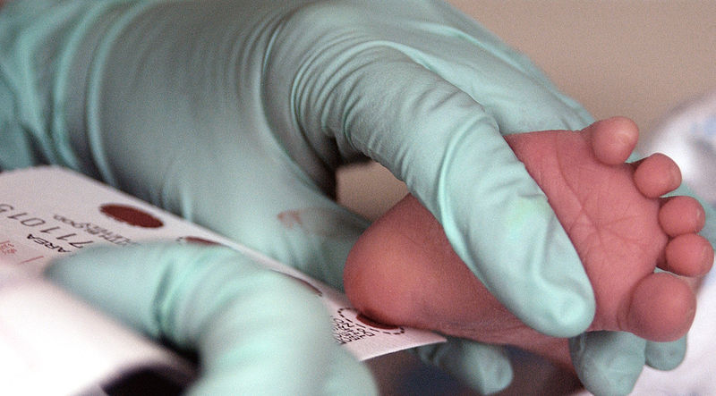
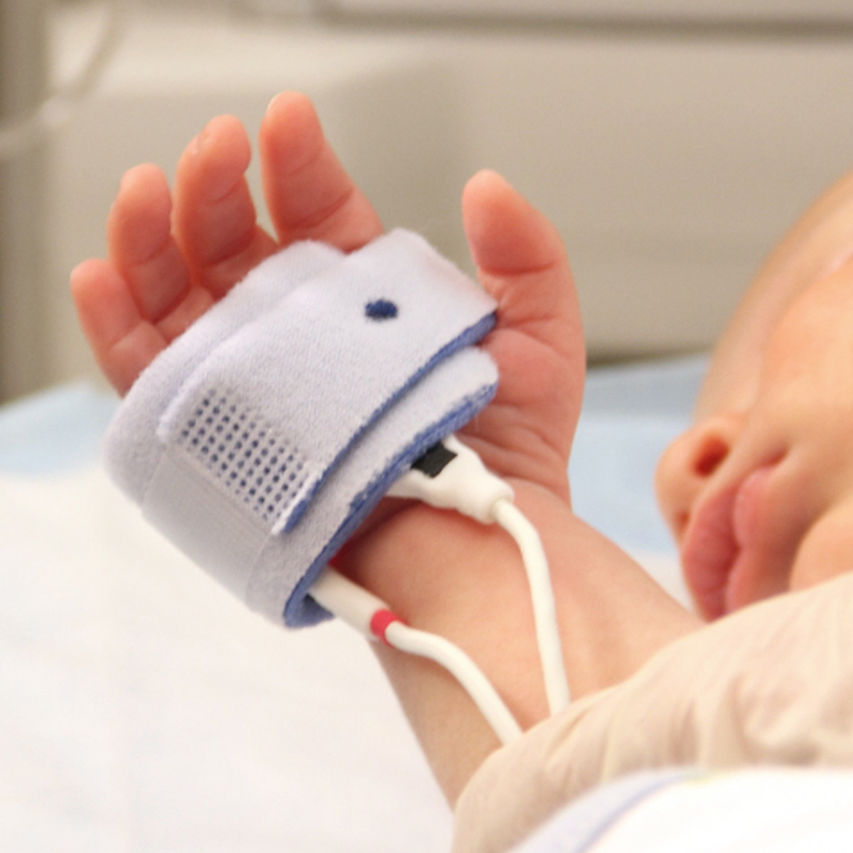
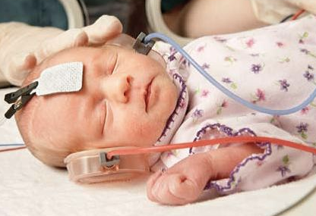
NewBorn Screening System
1. Newborn Screening Proper (NBS): Detection (57 diseases)
Dried Blood Spot
Screening
Point-of-Care
Screening
46 Inherited Metabolic Diseases (IMDs/IEMs)
Cystic Fibrosis
Primary Congenital Hypothyroidism
Haemoglobinopathies
Congenital Adrenal Hyperplasia
Severe Combined Immunodeficiencies
Pulse oxymetry
CCHD
Hearing screening
55 Diseases
+!
2. Short-term Follow-up (STFU): Confirmatory testing
3. Long-term Follow-up (LTFU)
Life-long treatment & intervention (nutritional and/or medical)
Growth and development monitoring, Treatment improvement
+!

Slide 30
The Data
Screening Data
DBS screening results
Gestational age
Birth weight/height
STFU Data
Confirmatory test results
Genetic mutation info
LTFU Data
Dietary intakes
Metabolite concentrations
Full blood count
Anthropometric measurements
Body composition, Bone density
Imaging data (MRI, EEG, CT, Xray)
Psycho-cognitive-motor assessments
Clinical history, Neurotransmitter levels
• Continuous Quality Improvement of Patient Treatment and Outcome
• Translational Research (Generates more data)
• New Knowledge Generation and Meaningful Use

Slide 31
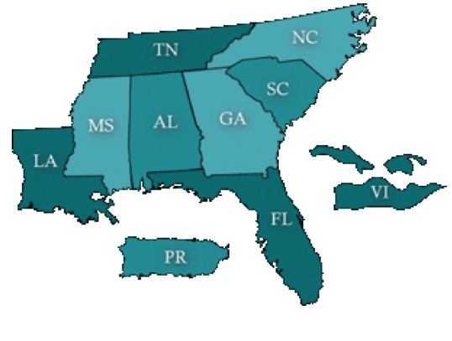



The Data = Challenge
1. Small number of patients with particular IMD
2. Patient data stored locally and in various formats
US SOUTHEAST
REGION
SAMPLE SIZE and
RESEARCH VALIDITY PROBLEM
3
4
3
3
1
5
2
0
SOULTION = DATA INTEGRATION
0
6
backed by

Slide 32
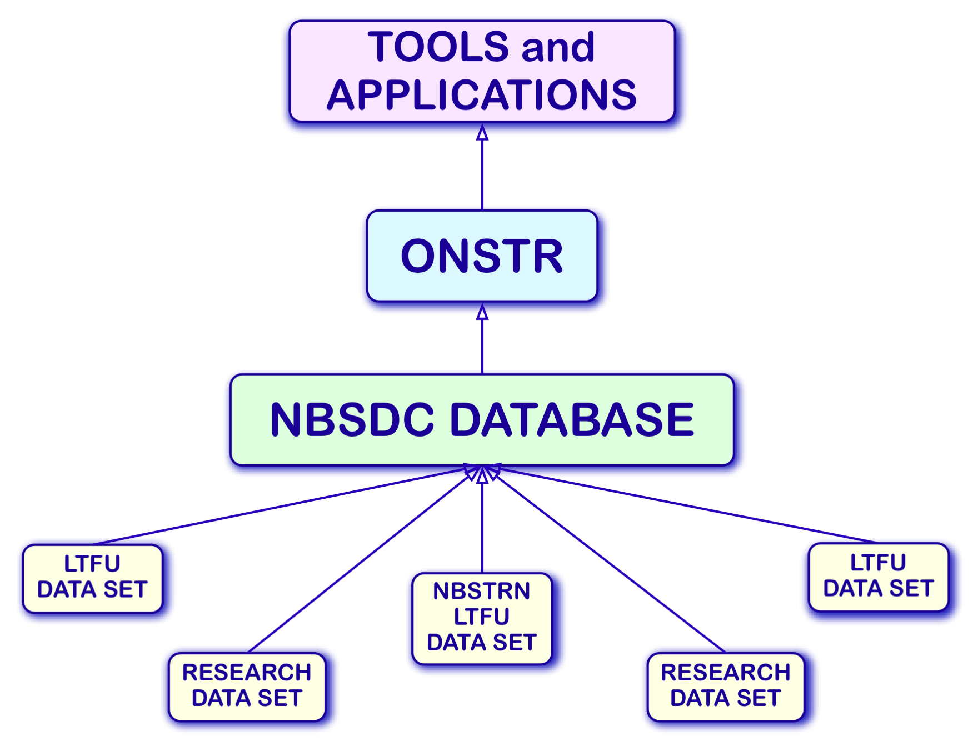
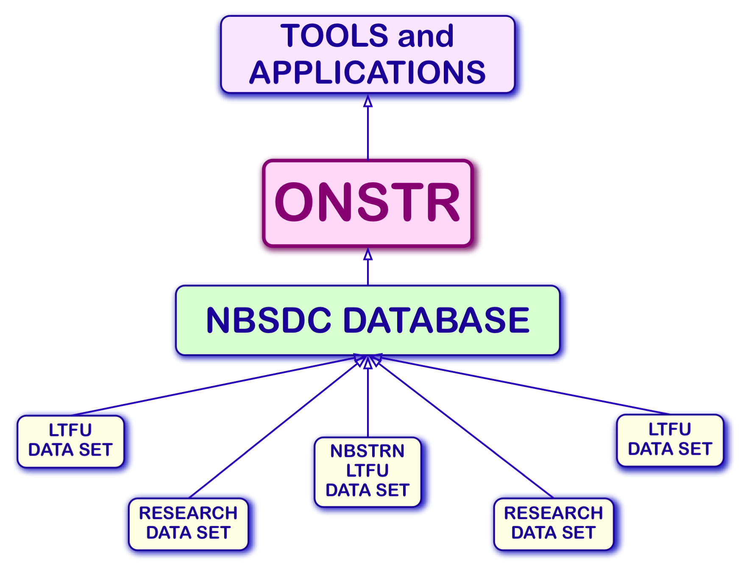
Our Solution: The Newborn Screening Follow-up Data Integration Collaborative
https://nbsdc.org

Slide 33

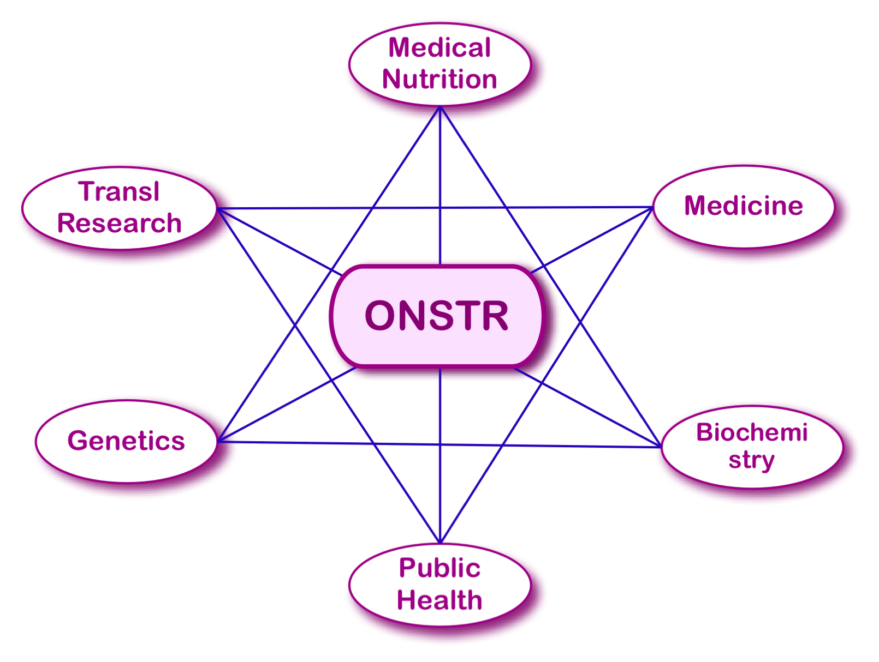

The Ontology for Newborn Screening Follow-up and Translational Research
 Application ontology (currently 1852 classes)
 Built by following
 Top-down bottom-up methodology
 OBO Foundry best practices:
BFO2
MIREOT (OBI, IAO, GO, PR, OGMS, ChEBI, PATO, CL, FMA...)
 Ontological realism
 Domain: Complex - Reflects the reality of NBS follow-up
 Data entities
 Processes
 Agents/Process participants

Slide 34
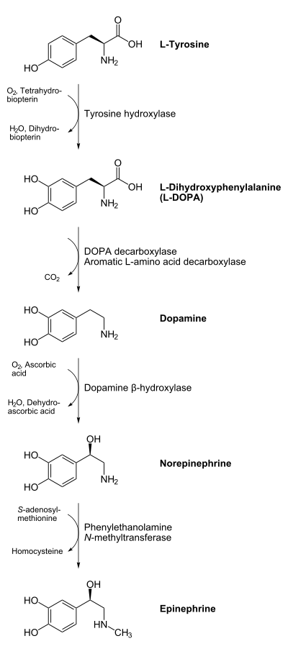
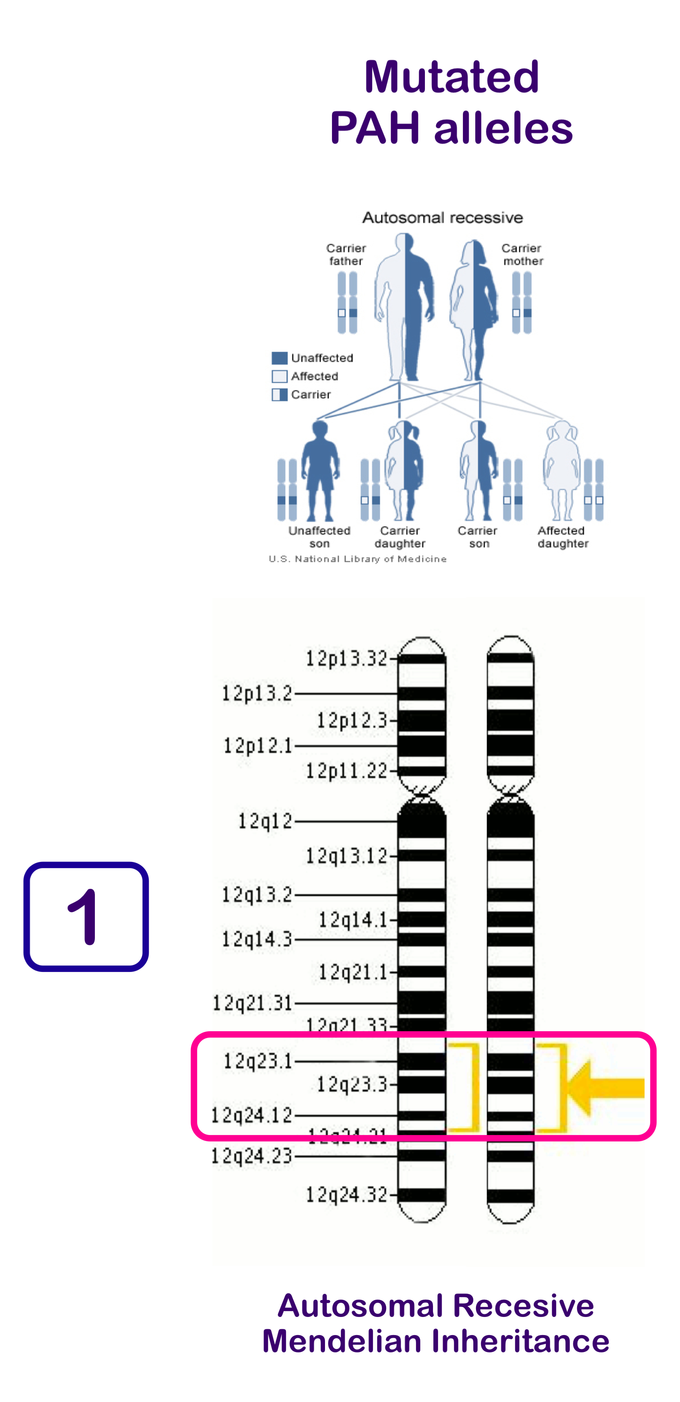
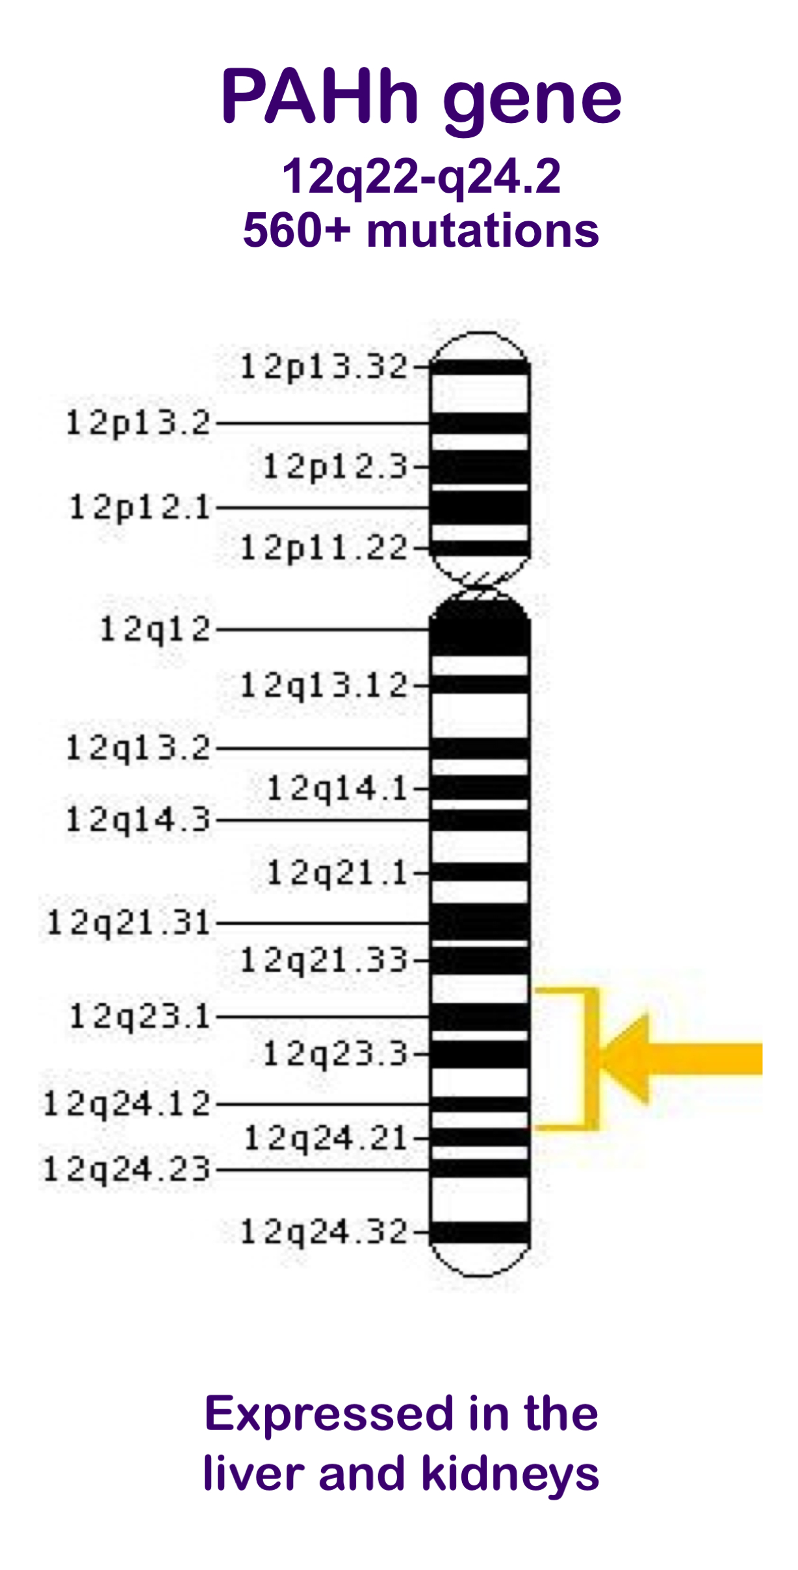
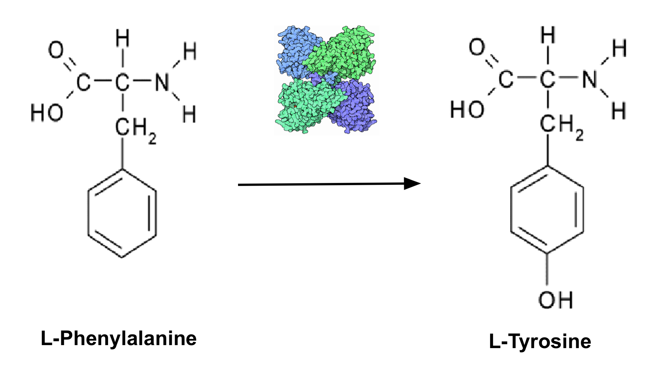
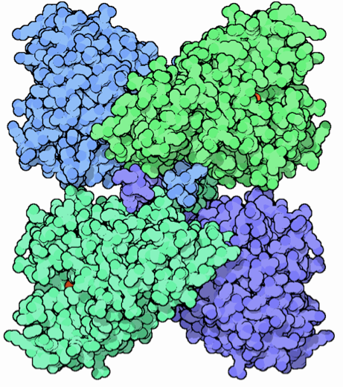
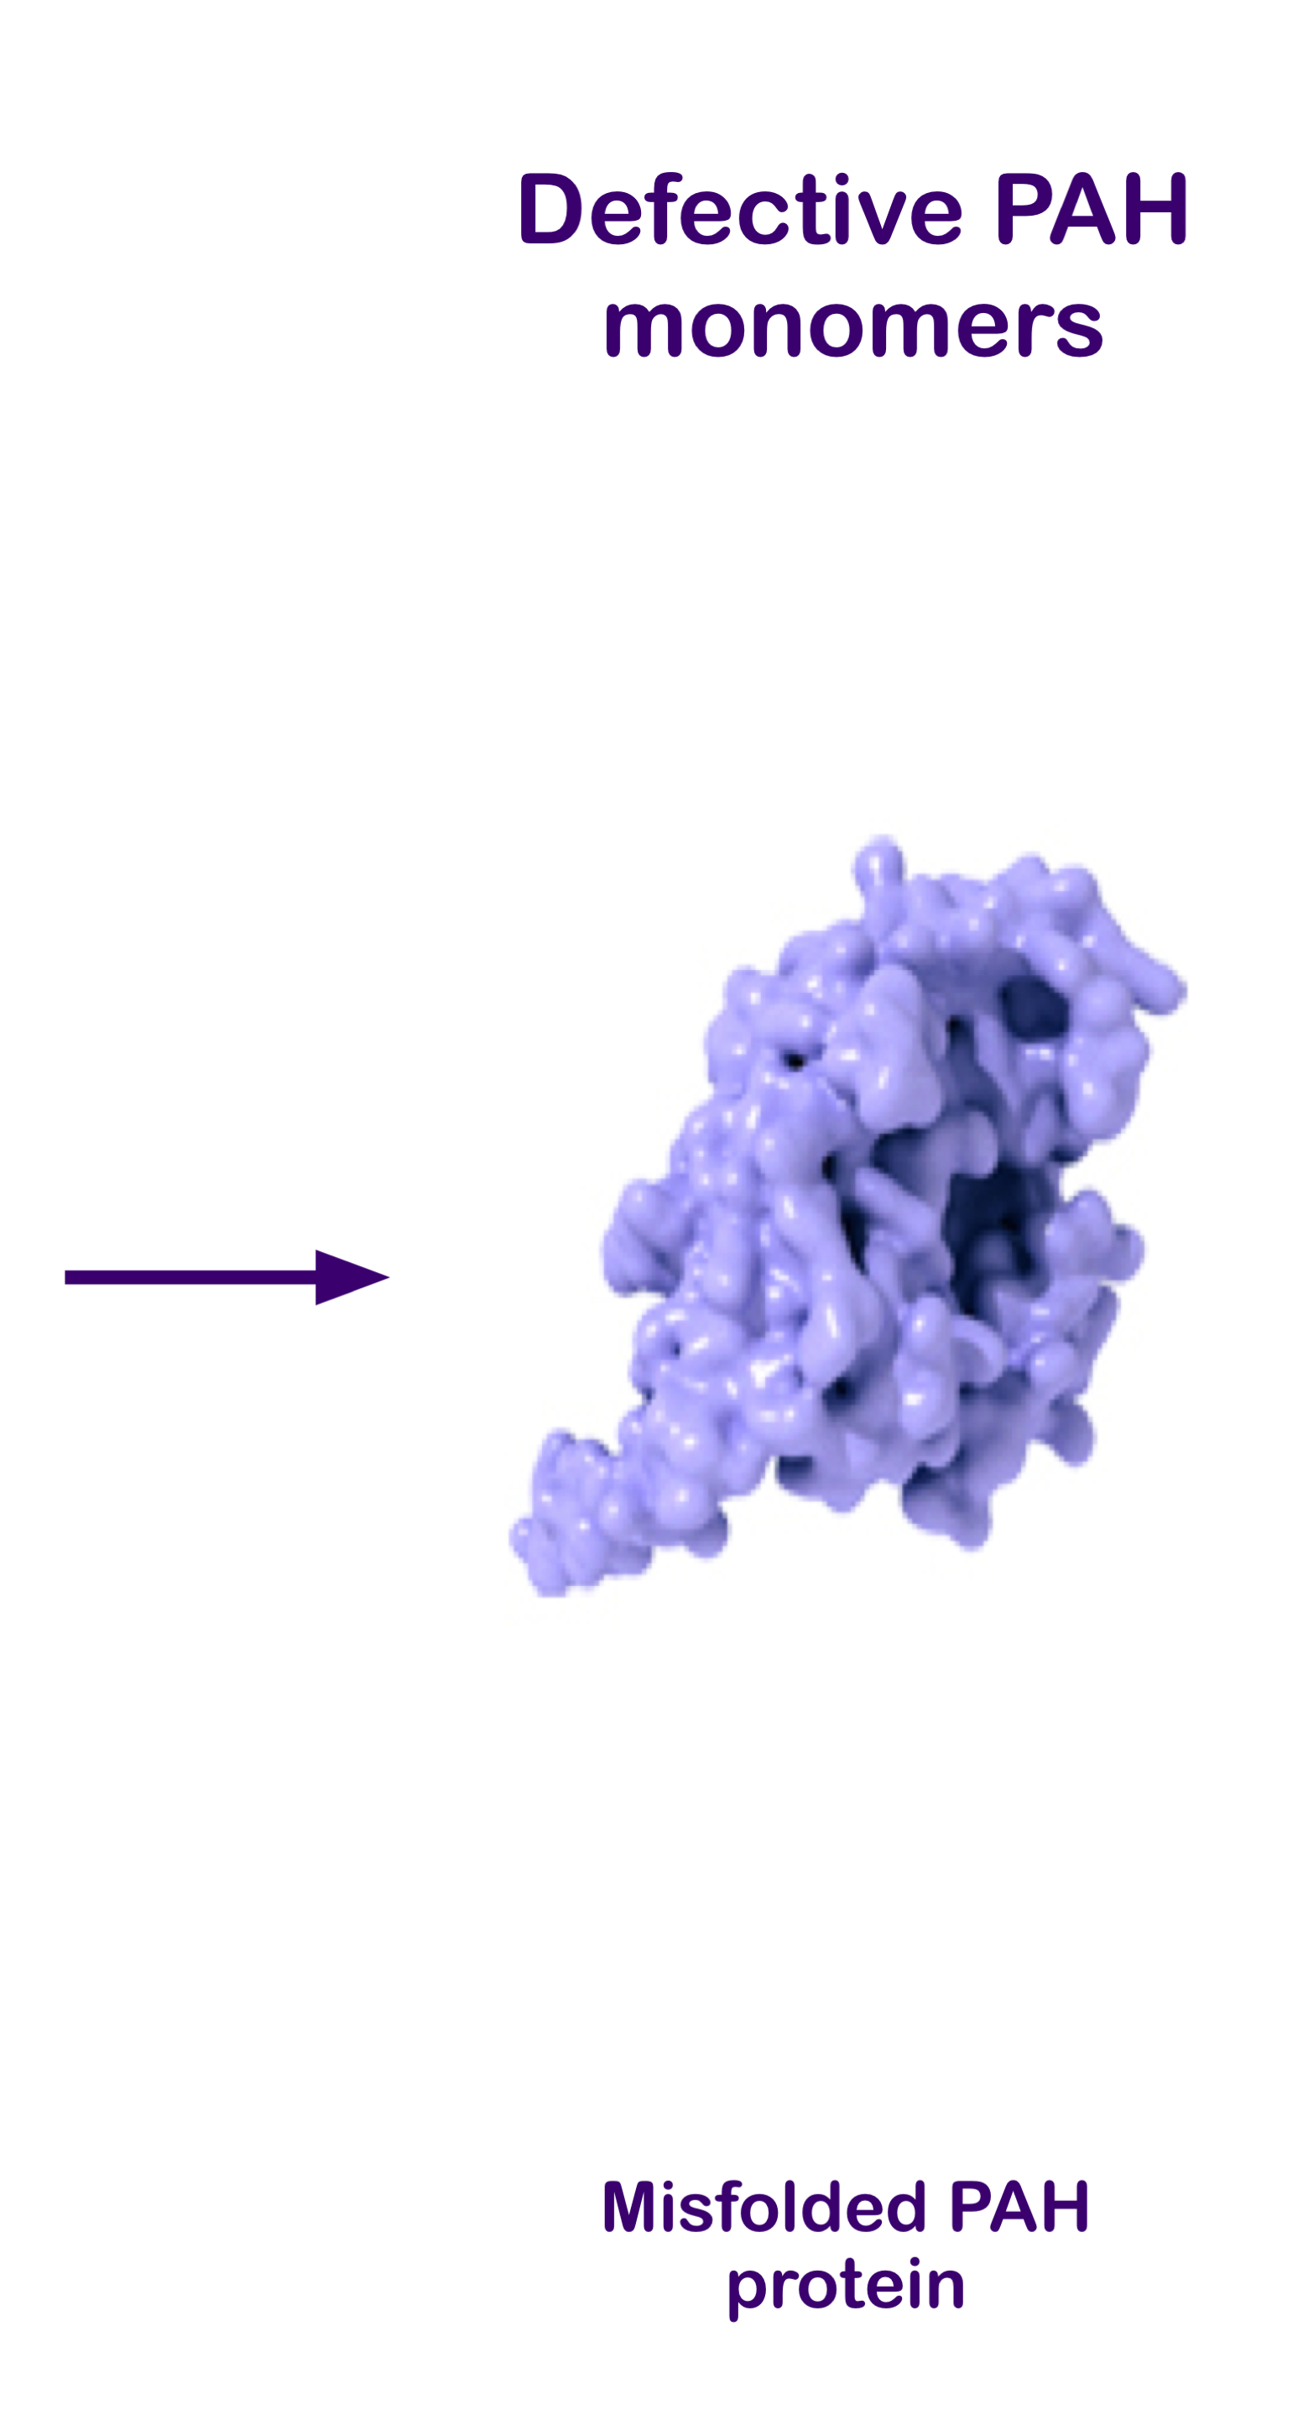
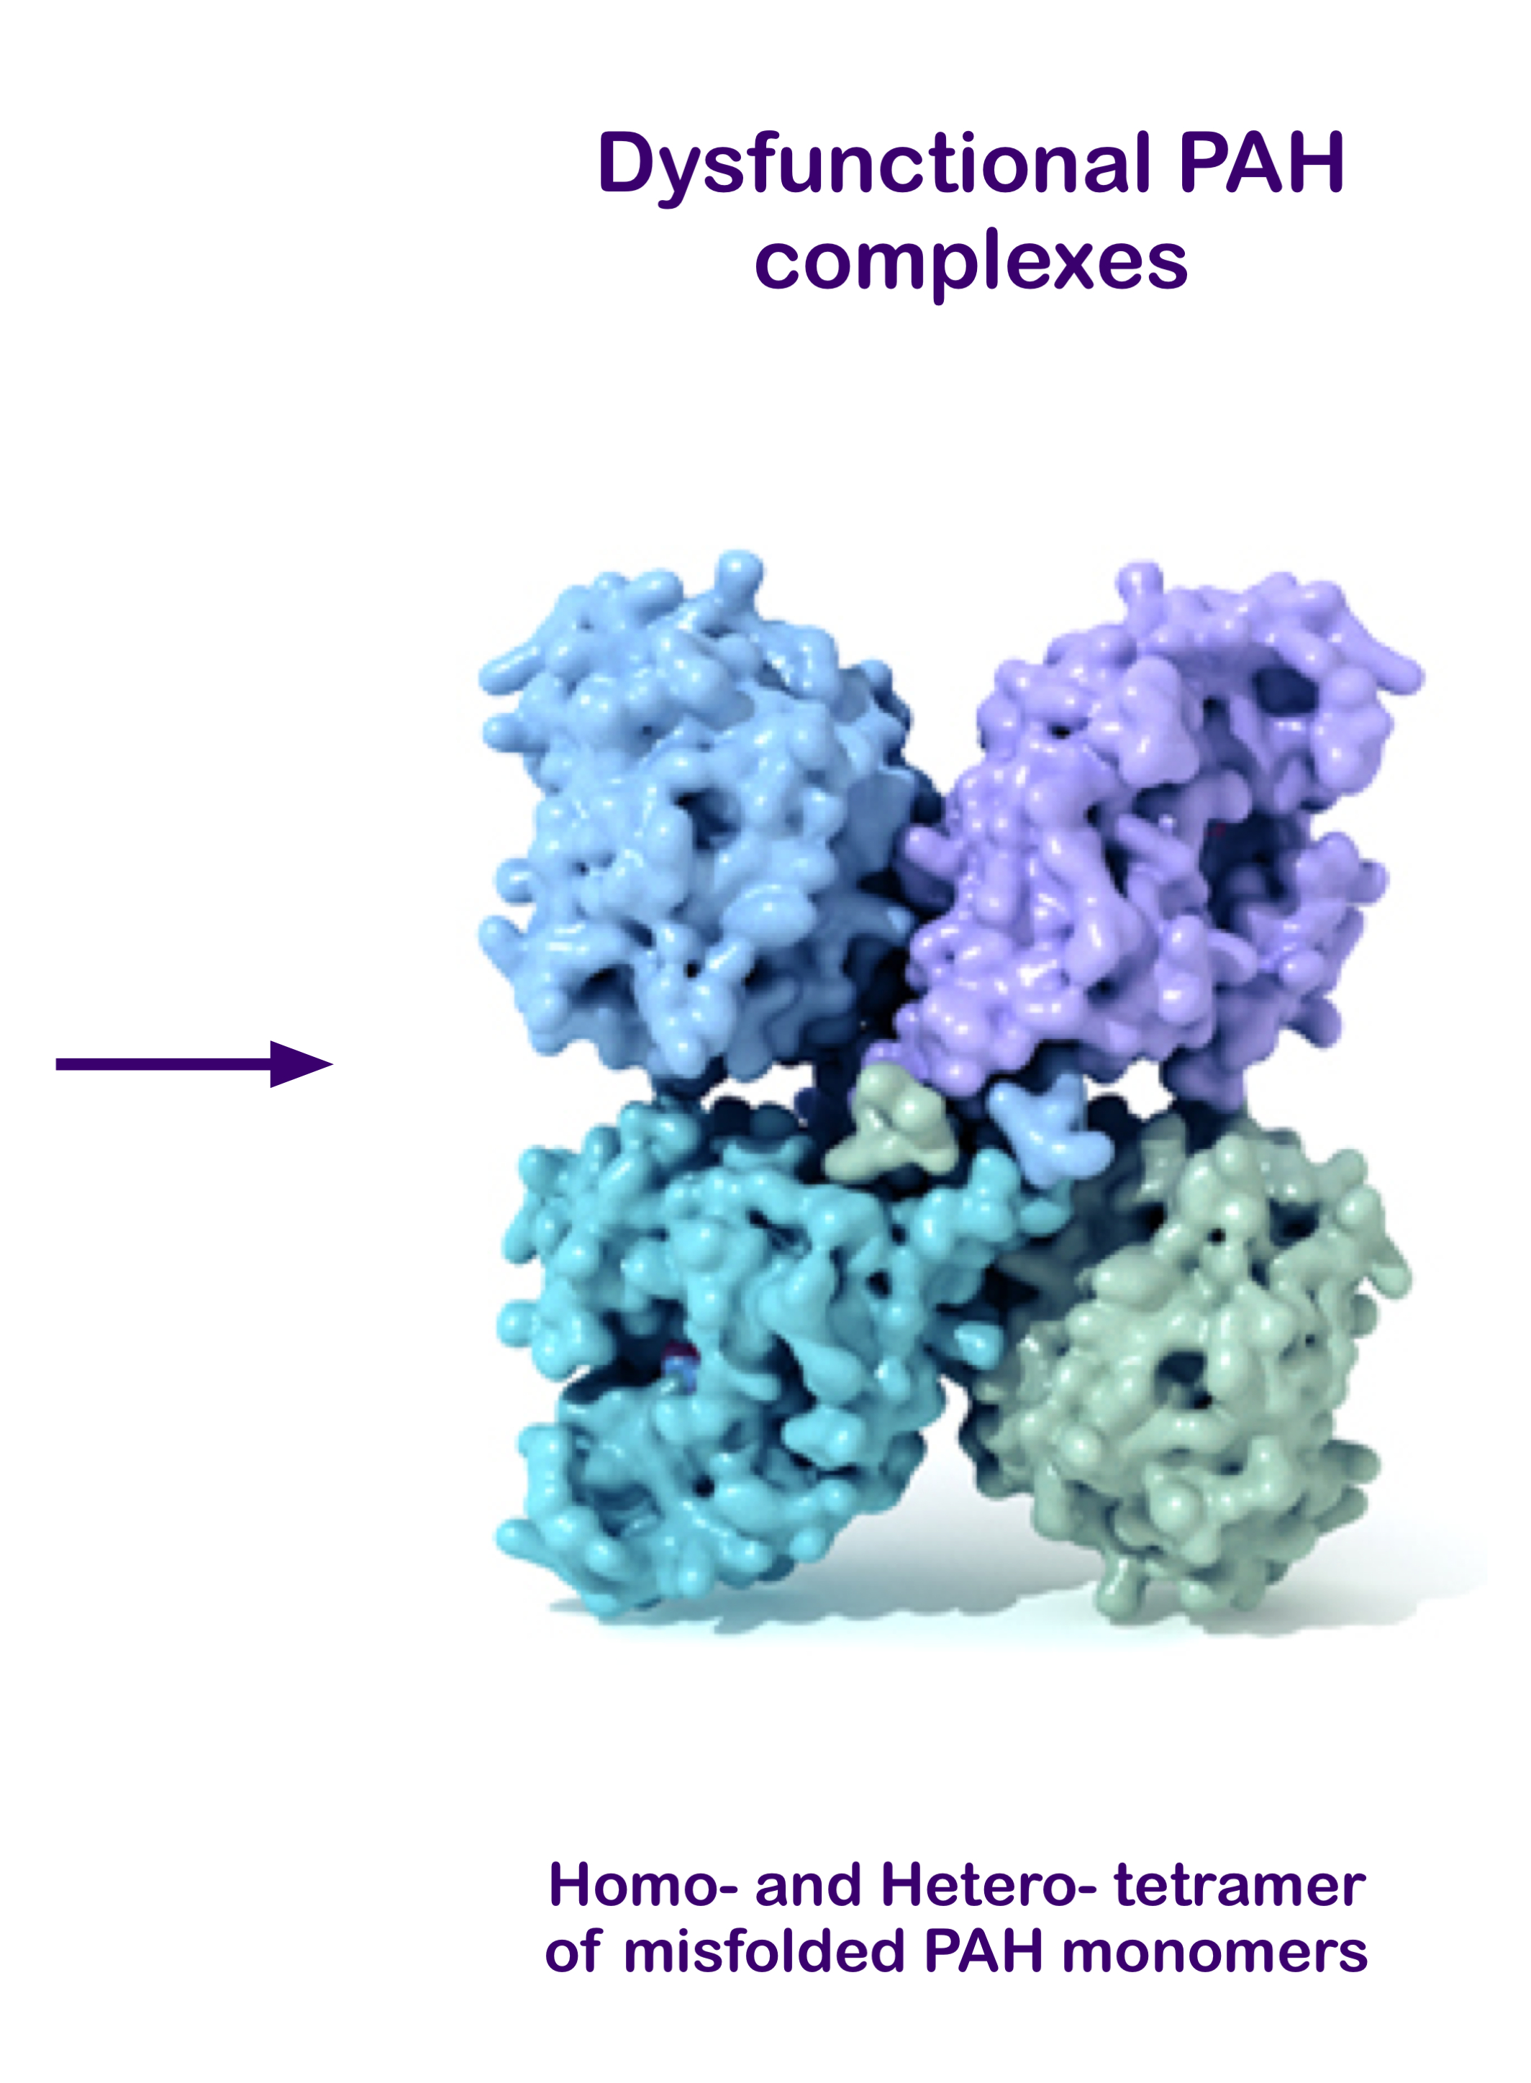
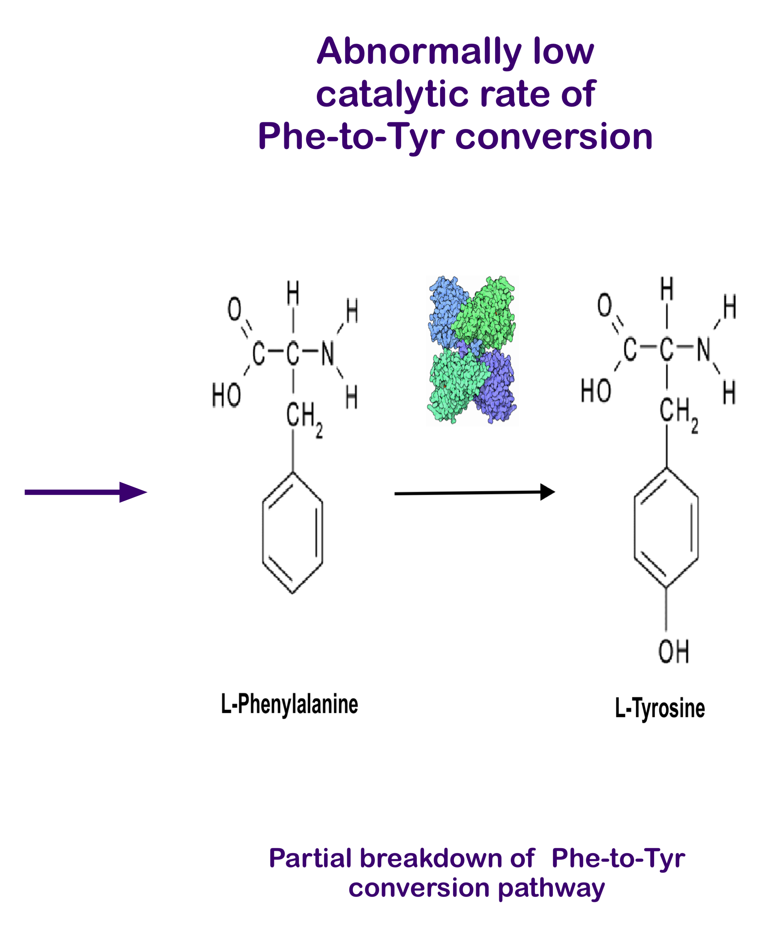
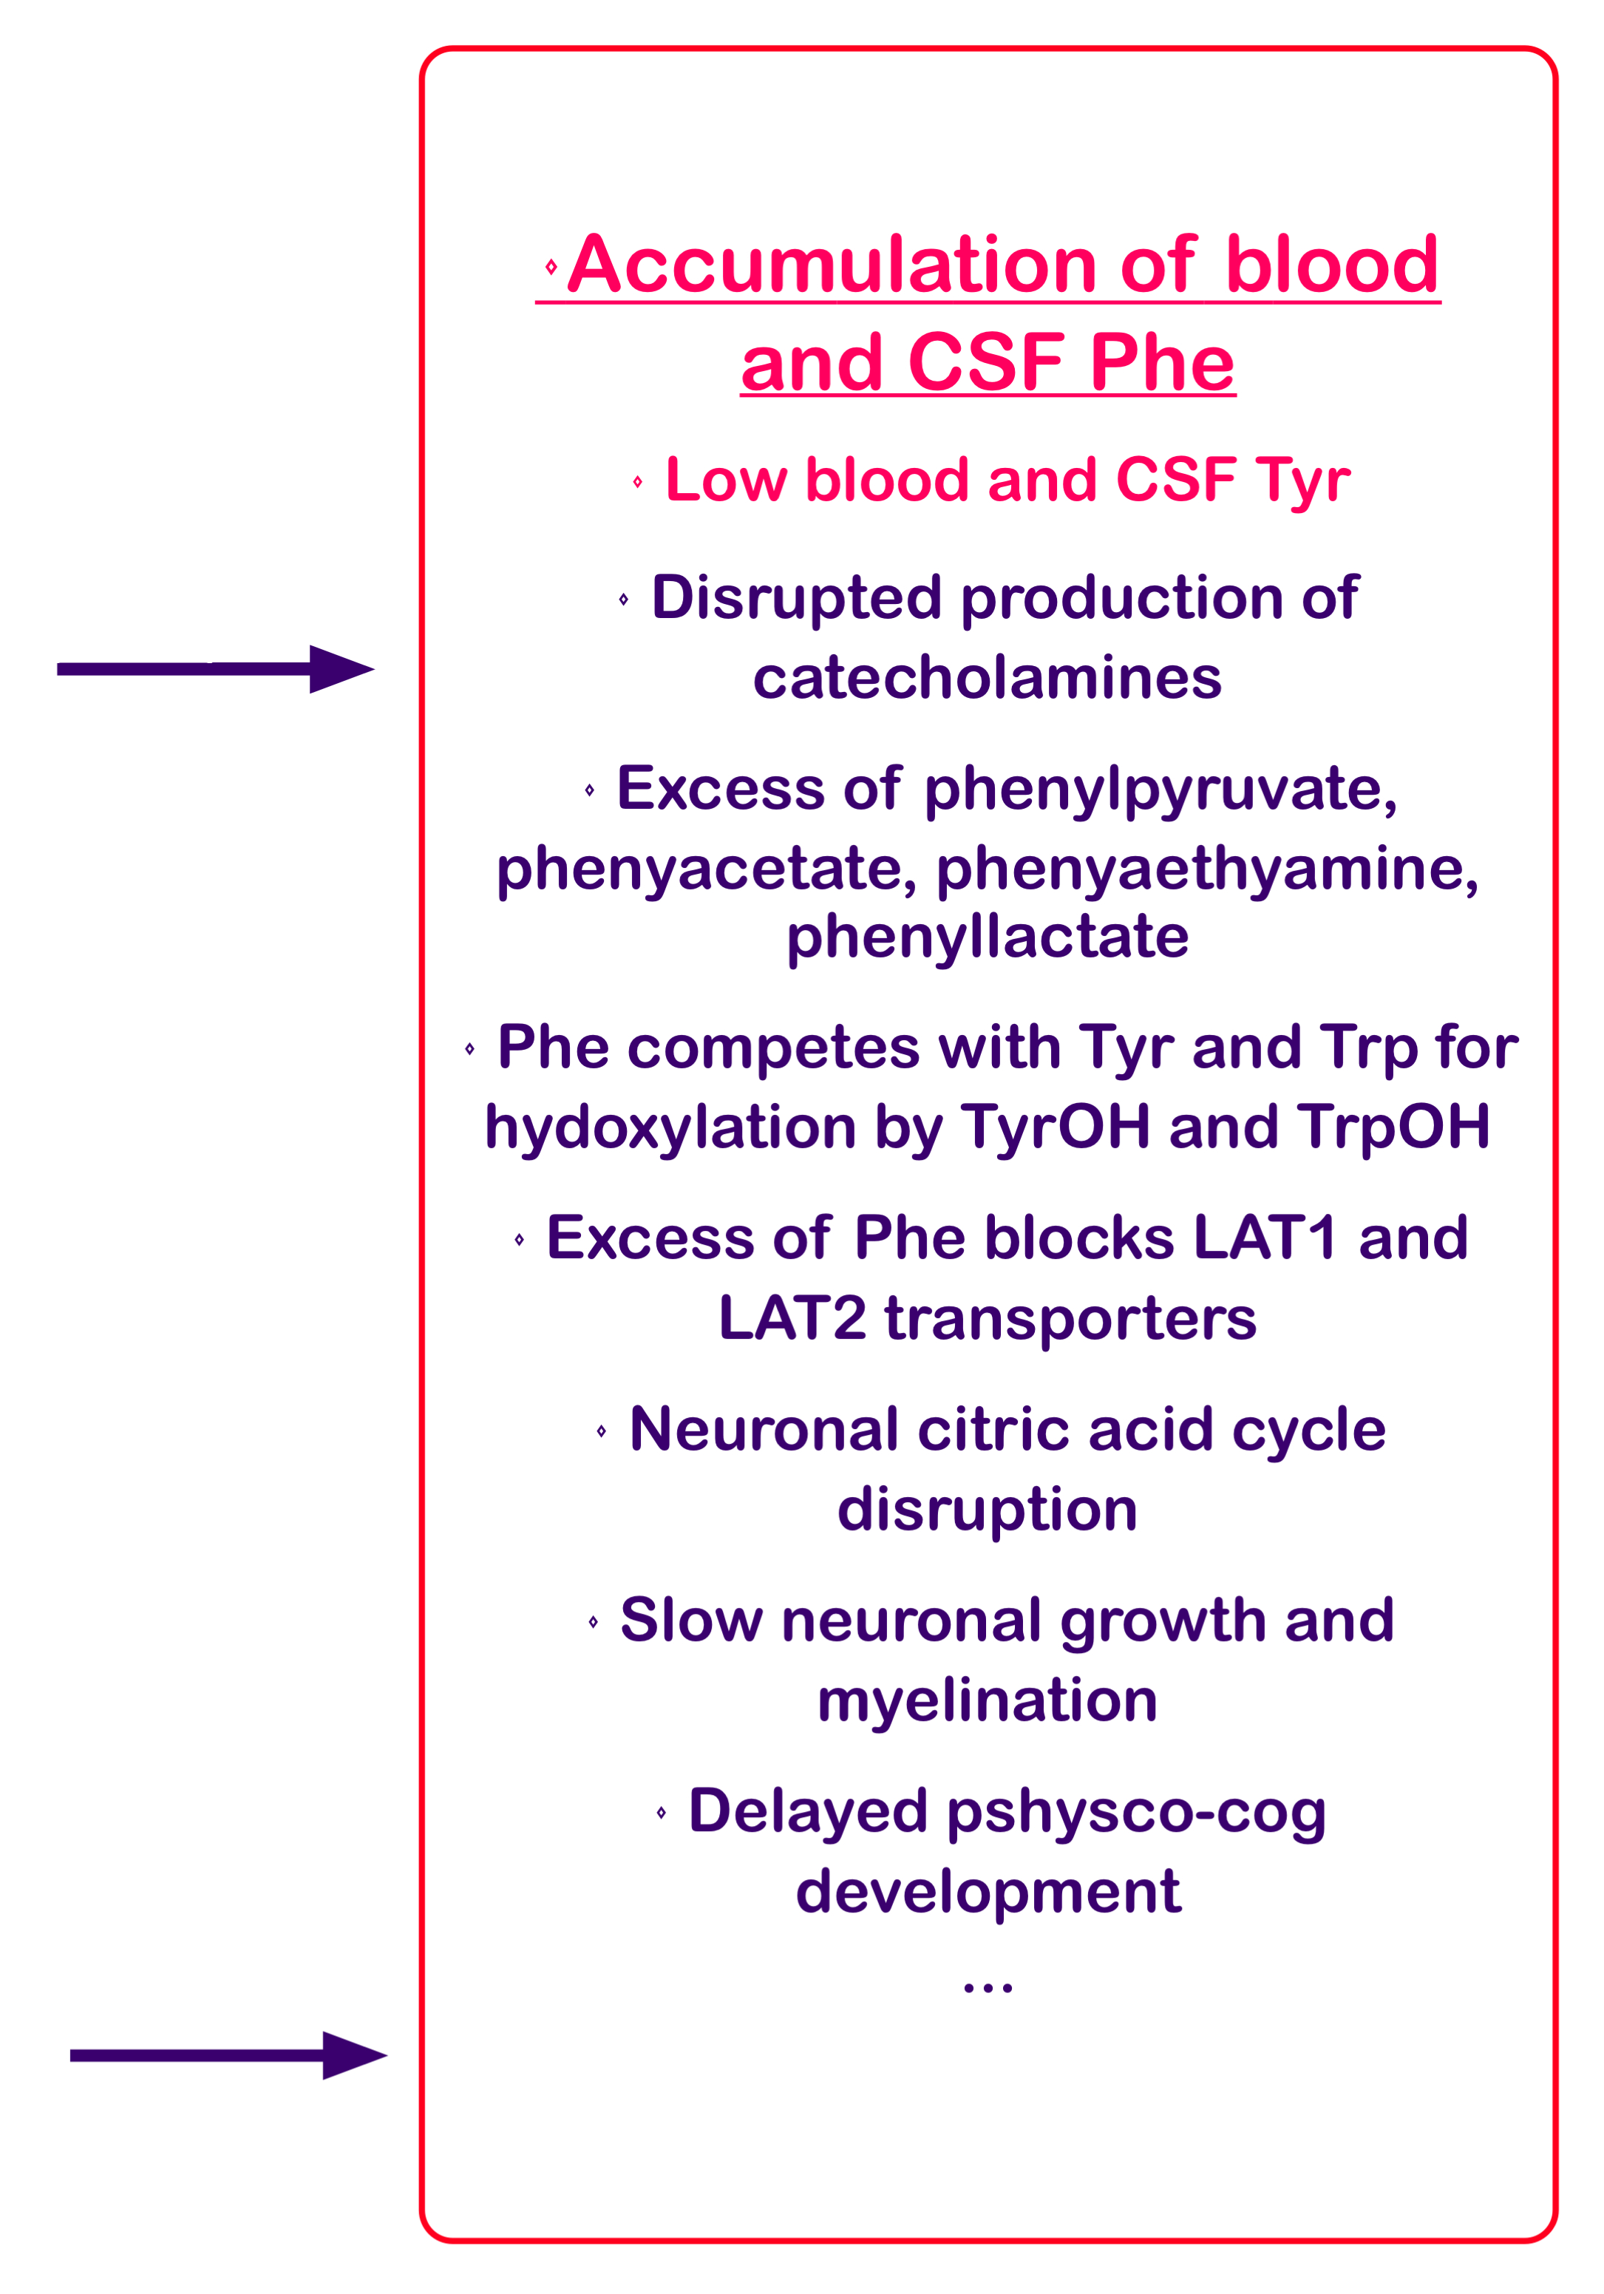
Etiology of HyperPhenylalaninemia (a.k.a PKU) (As an example applicable to all IMDs)
PAH
EC1.14.16.1

Slide 35
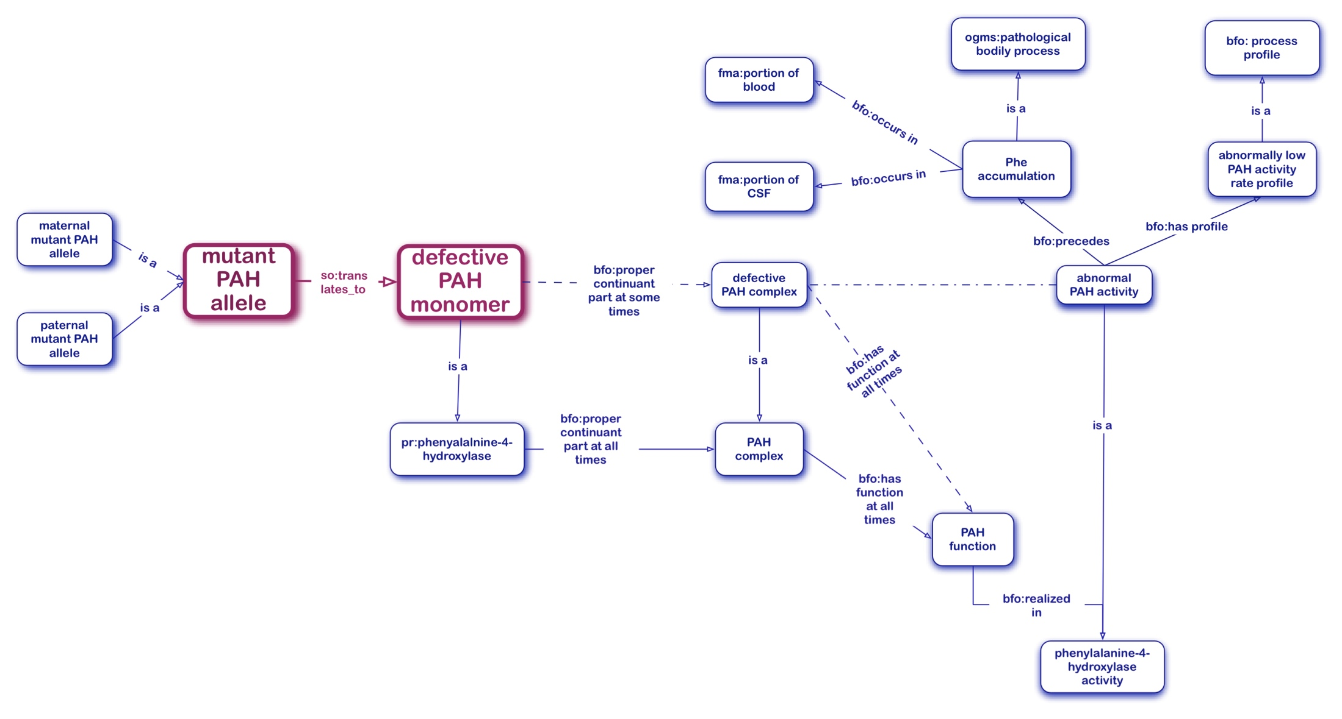
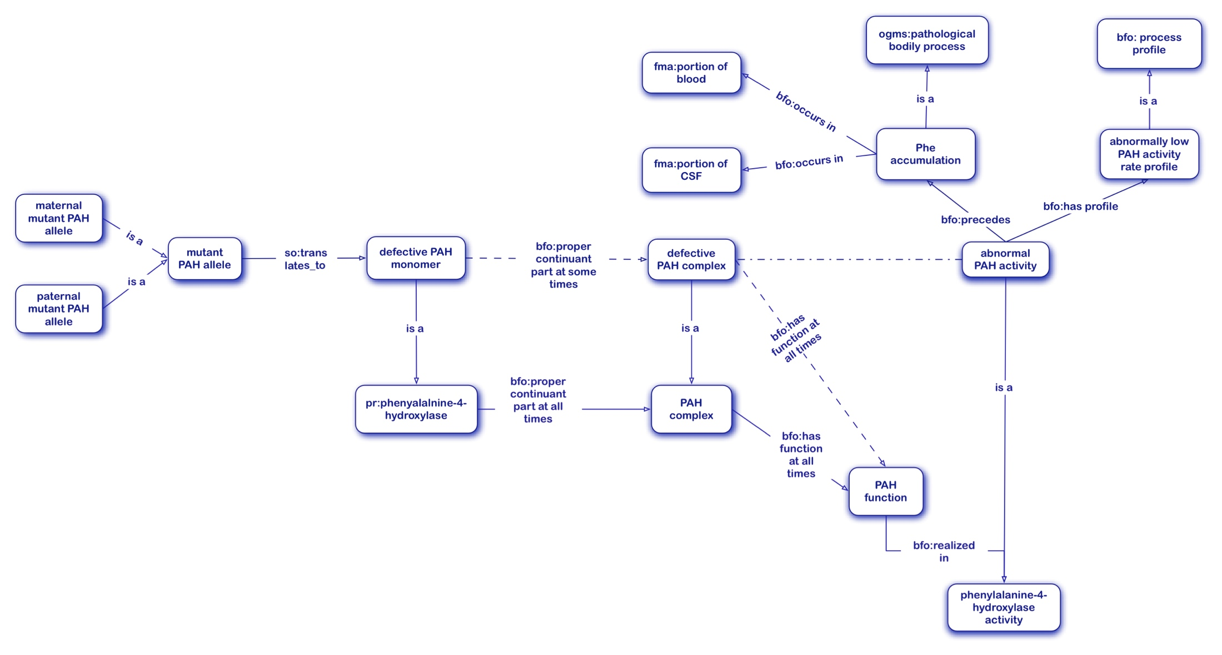
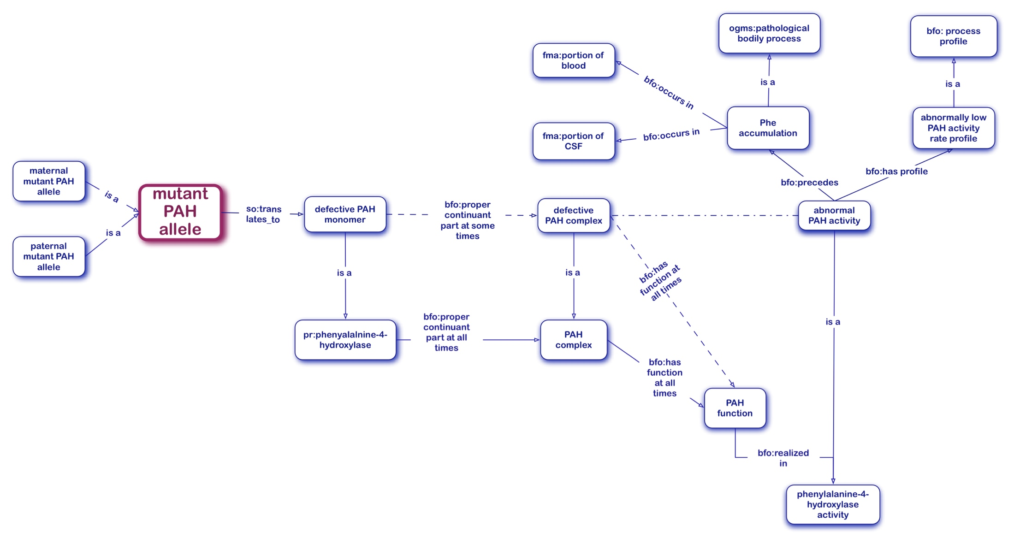
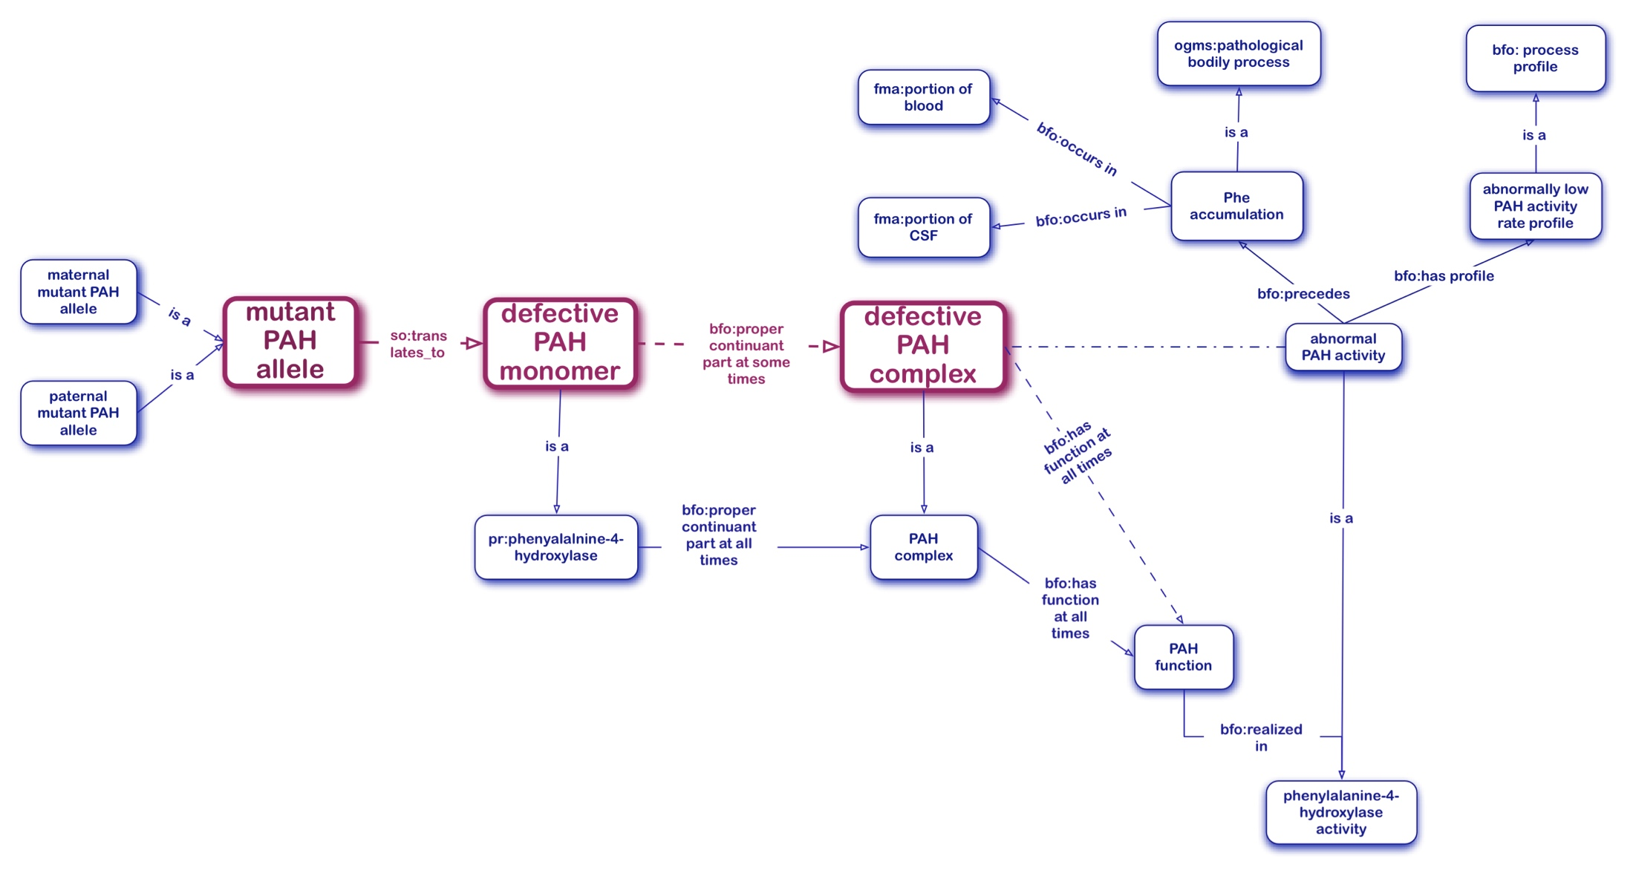
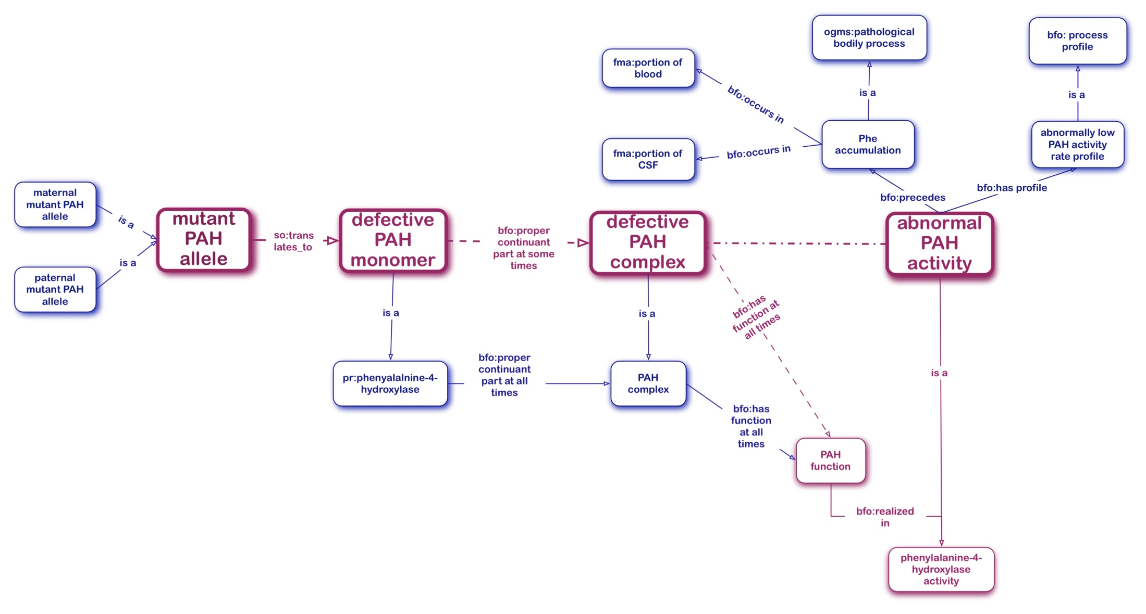
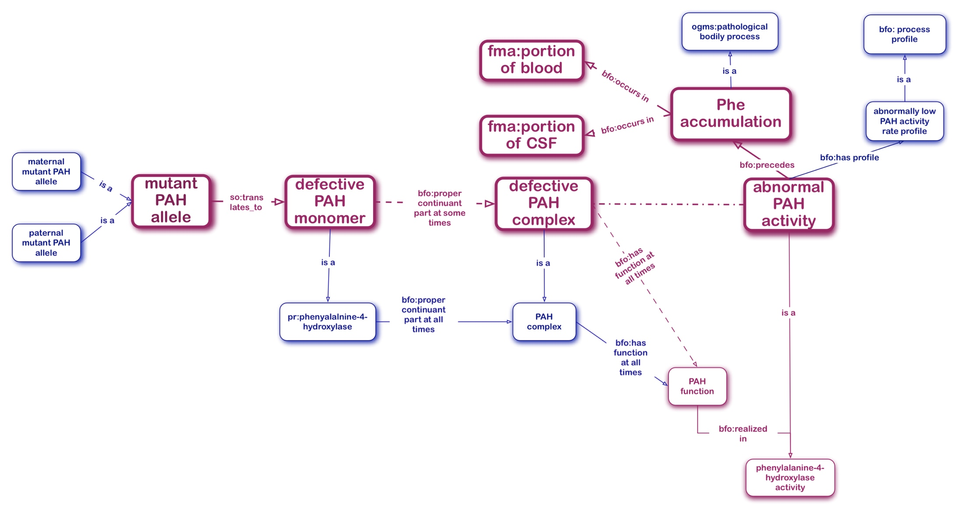
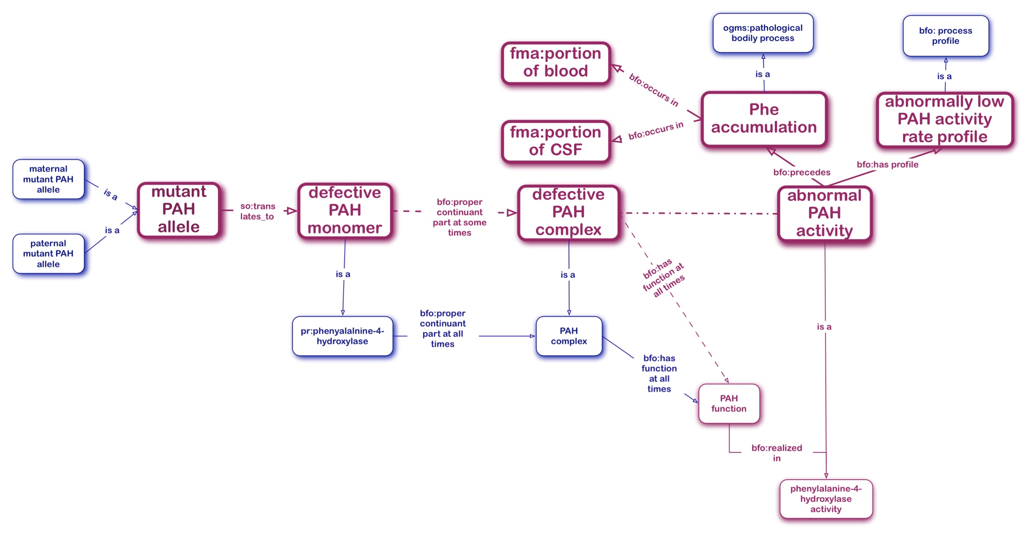
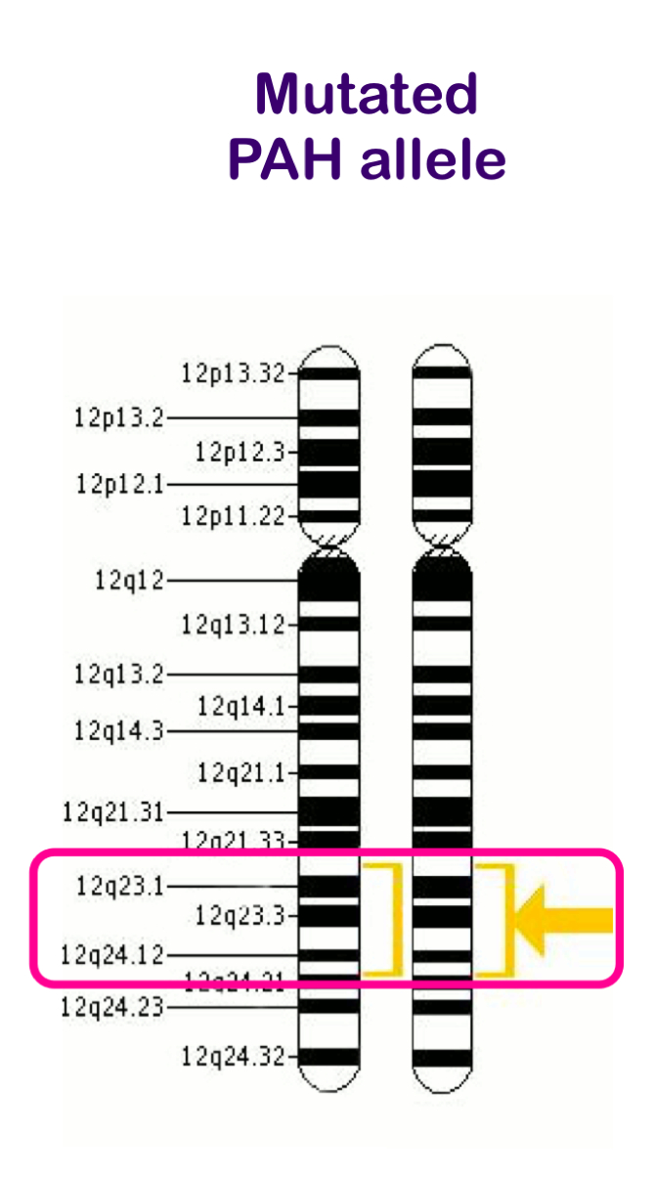
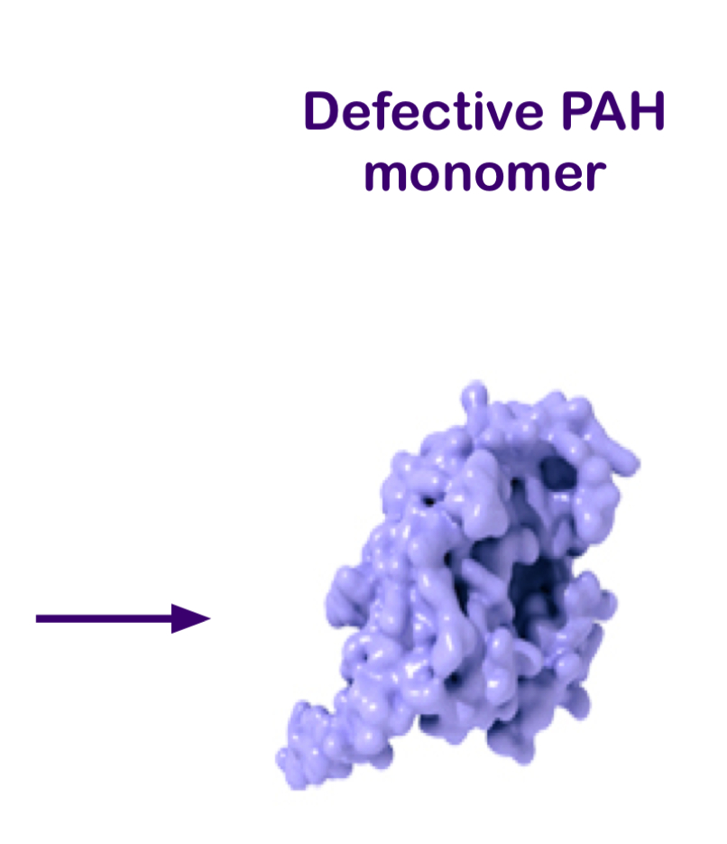
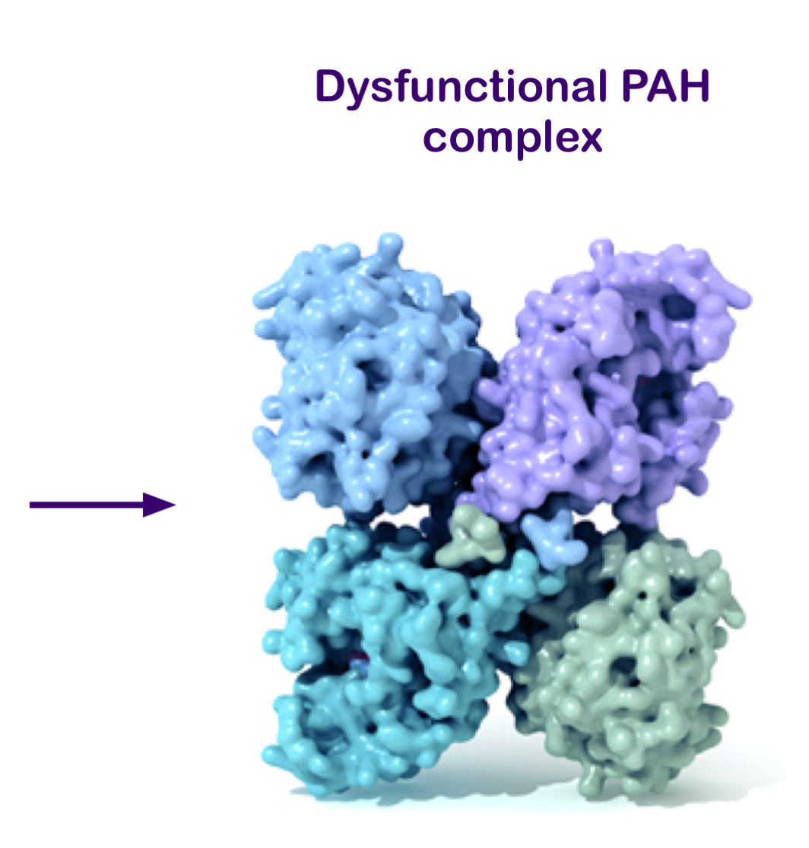
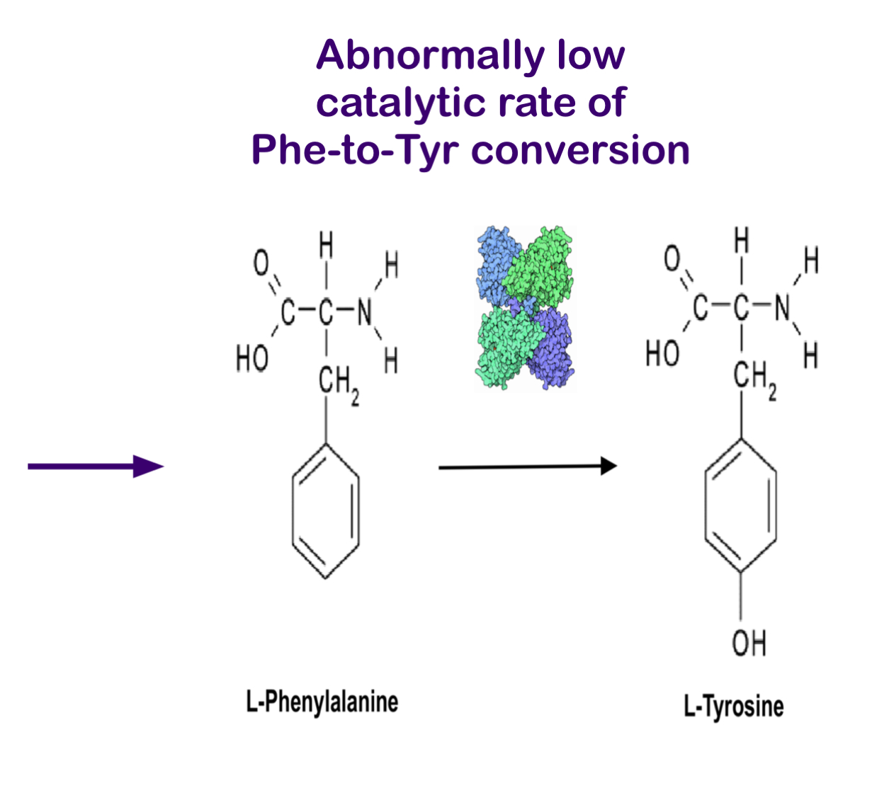
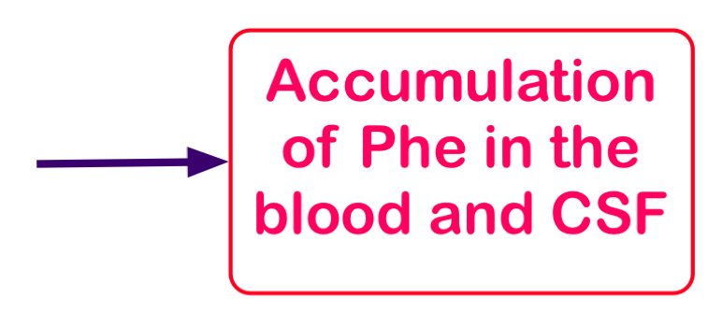
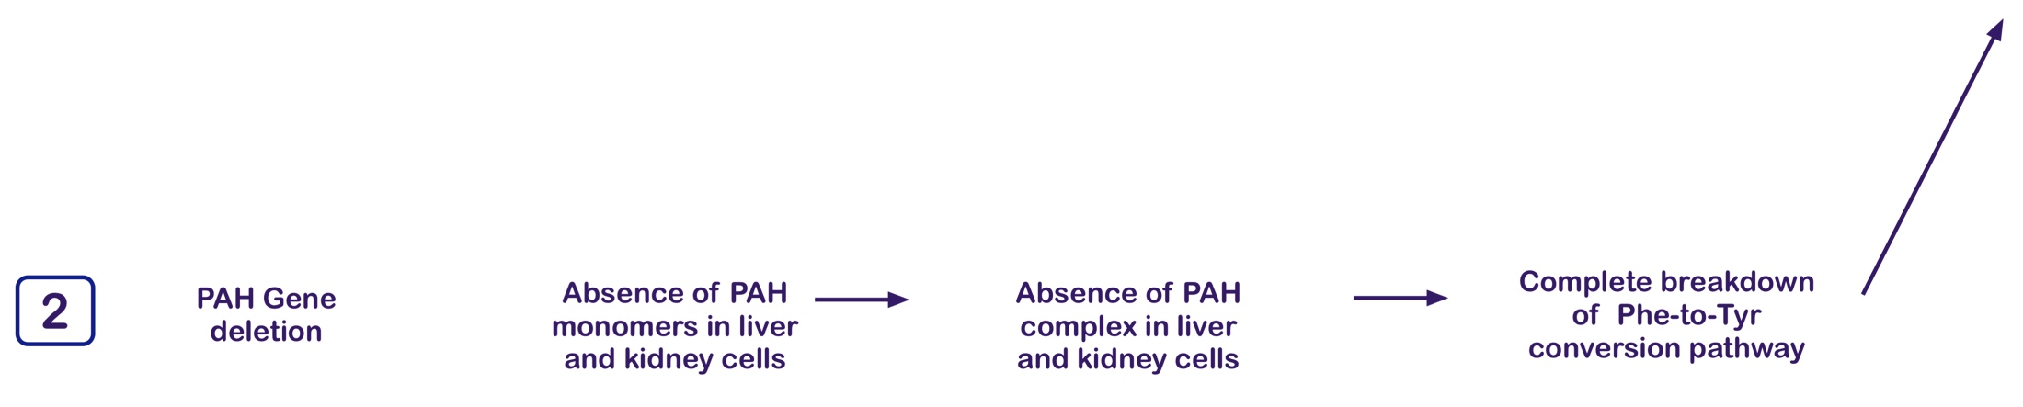
Ontological Model of the Etiology of Hyperphenylalaninemia (Applicable with modifications to all IMDs)
BFO2:
process profile
2 ?!

Slide 36
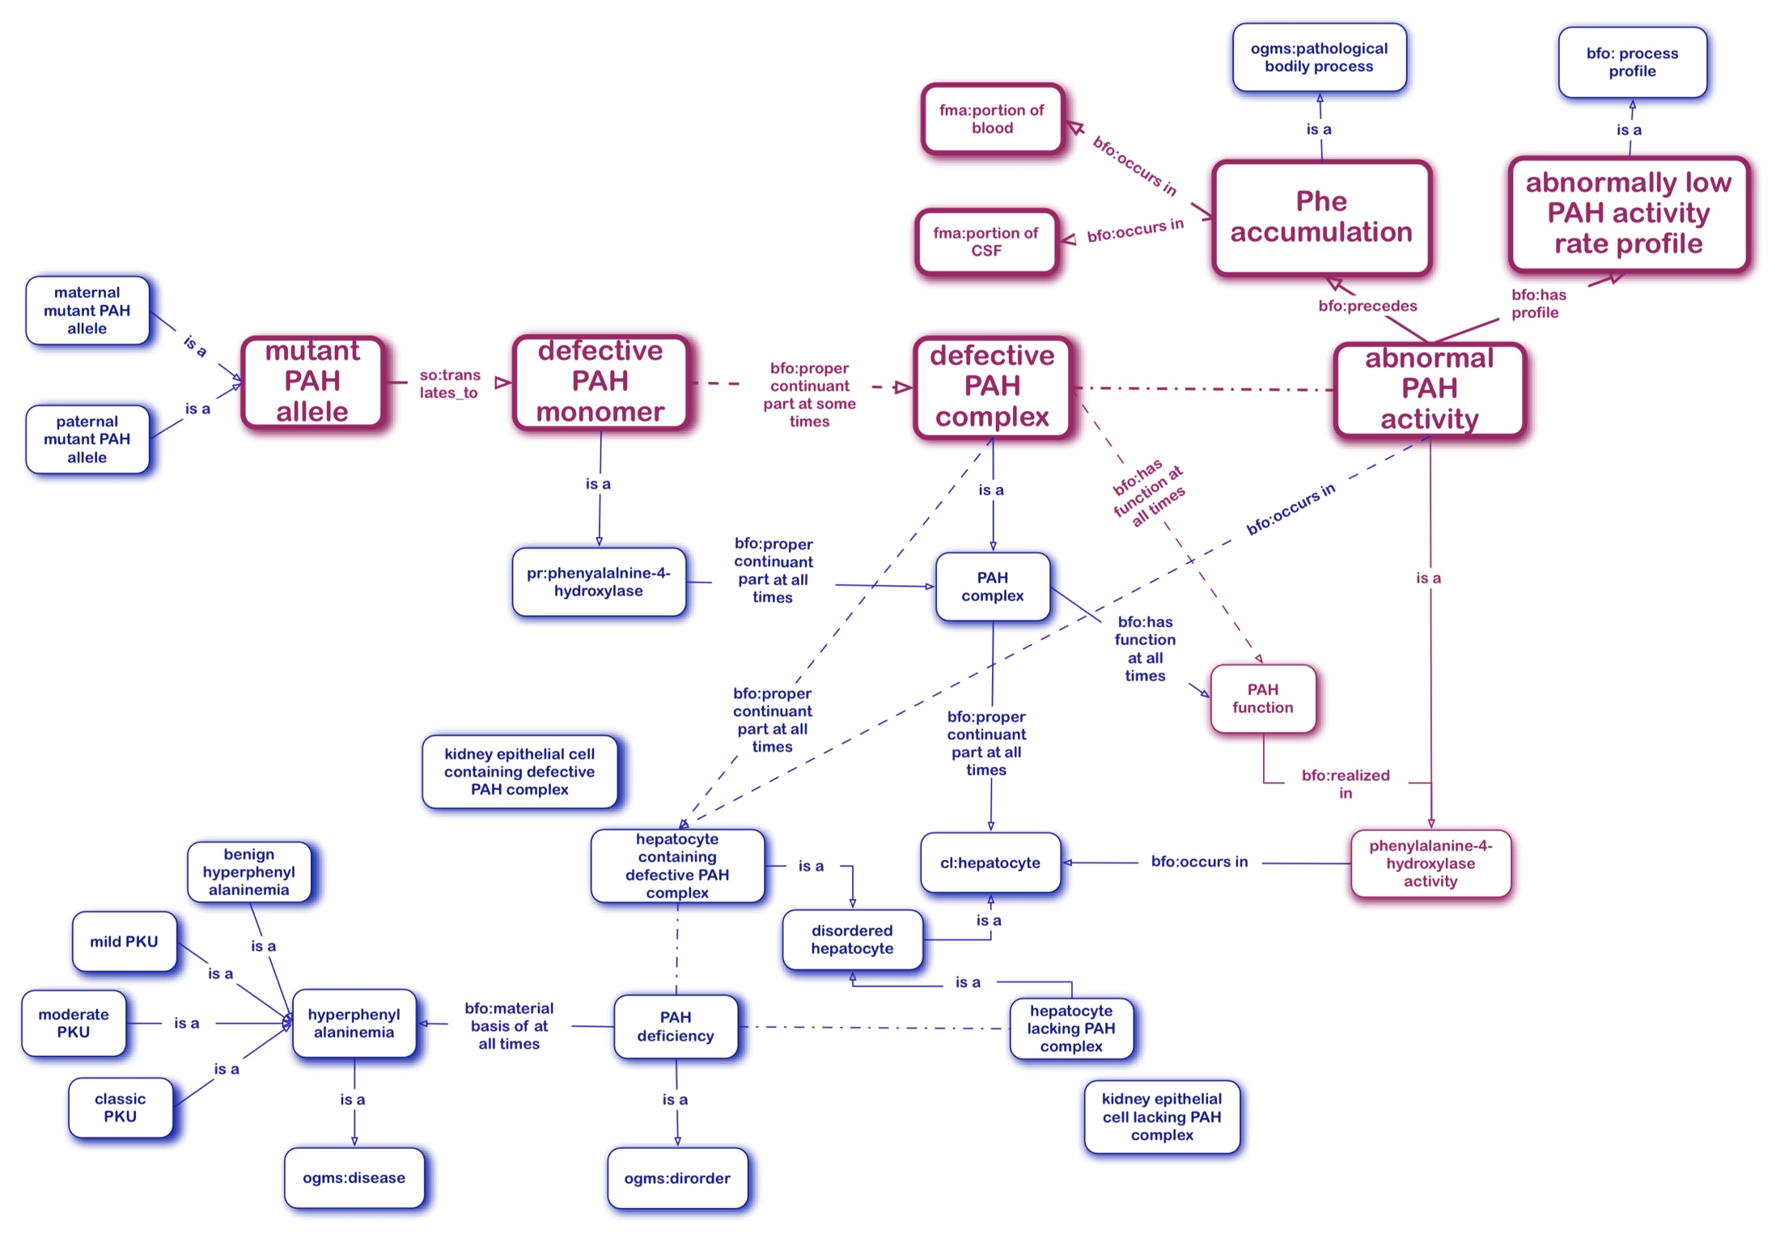
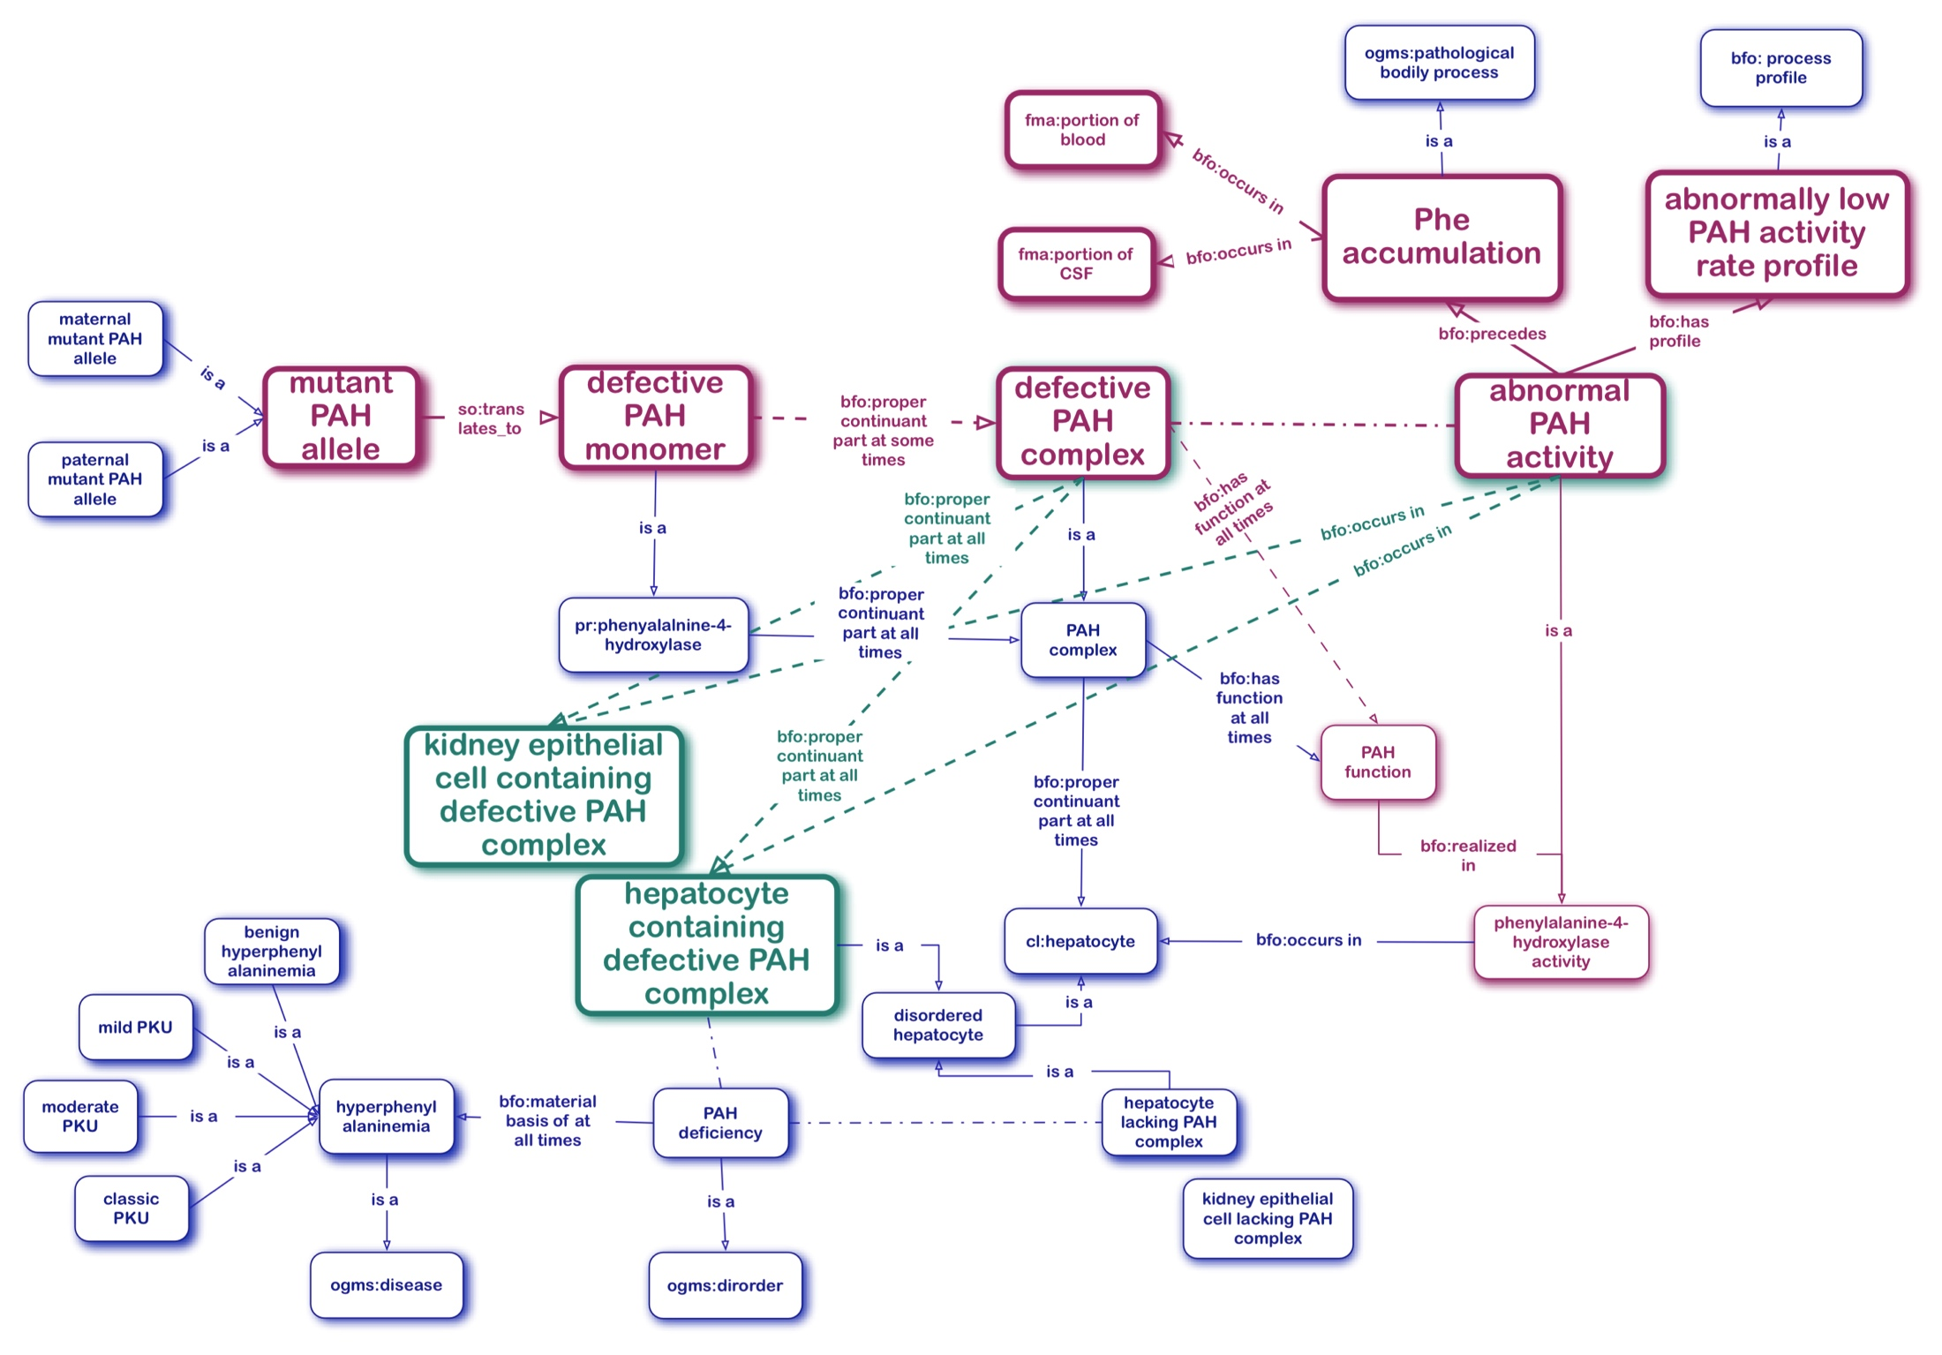
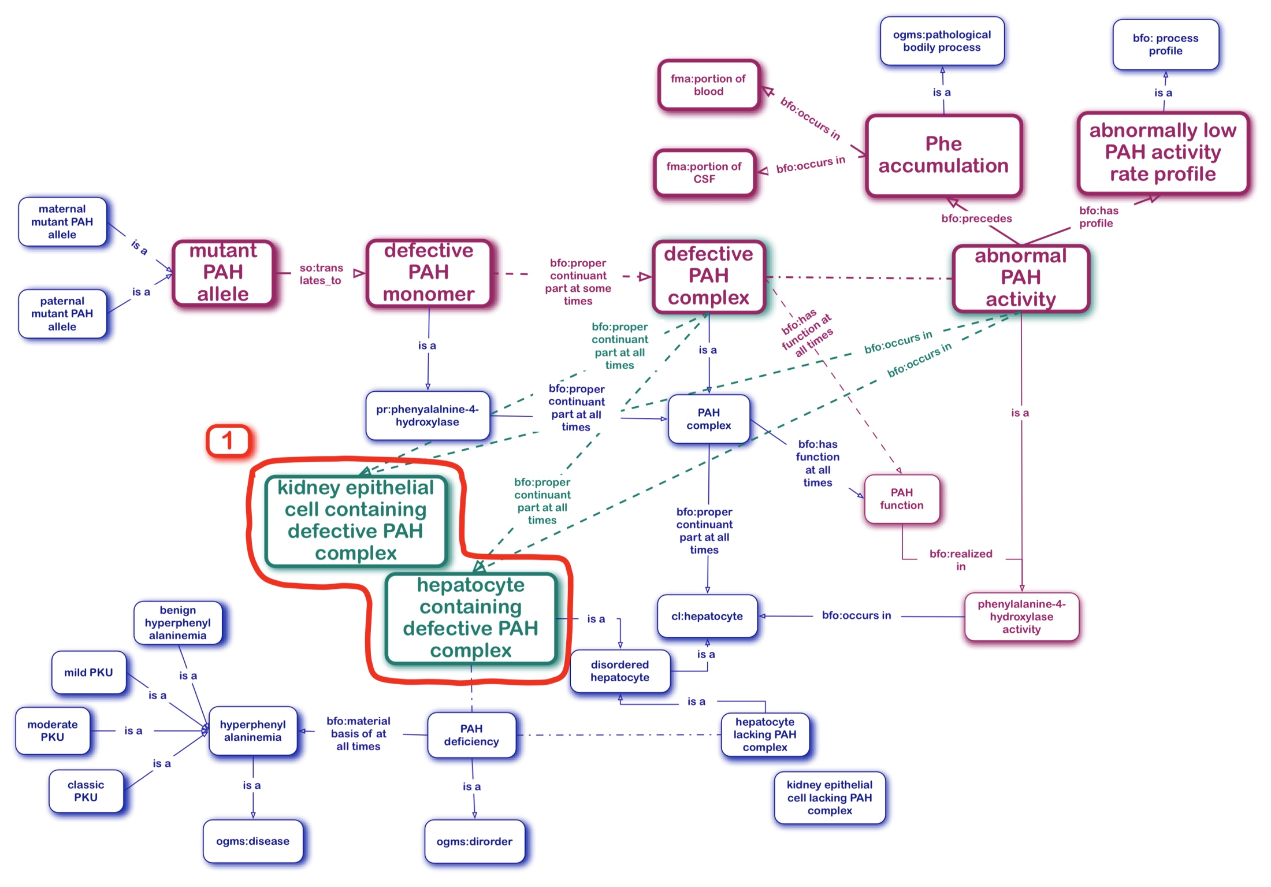
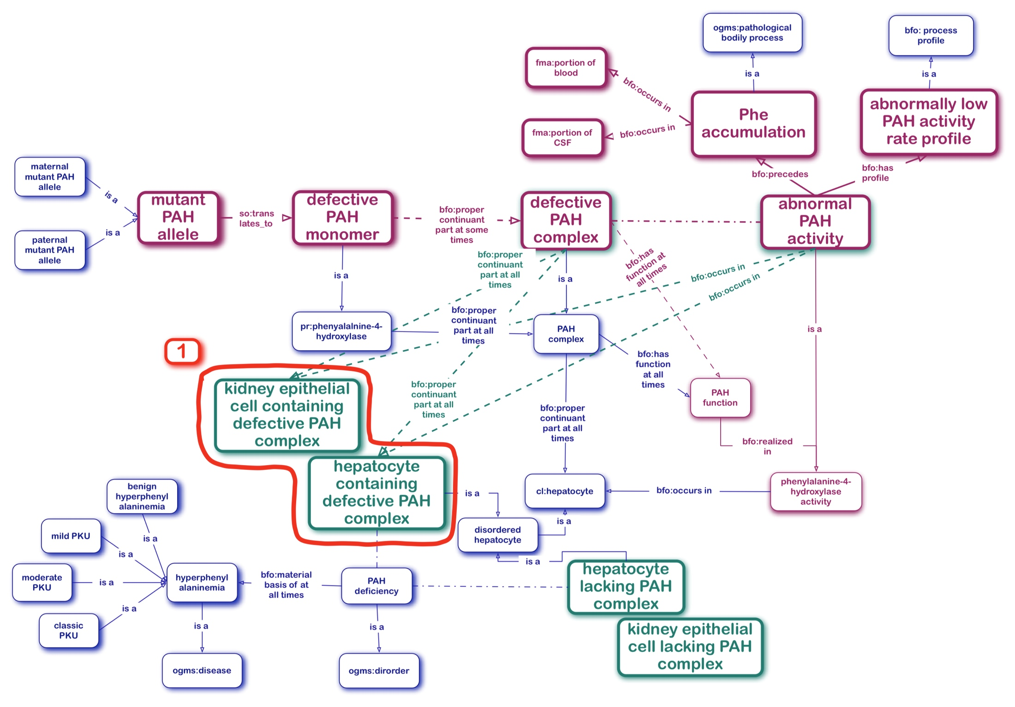
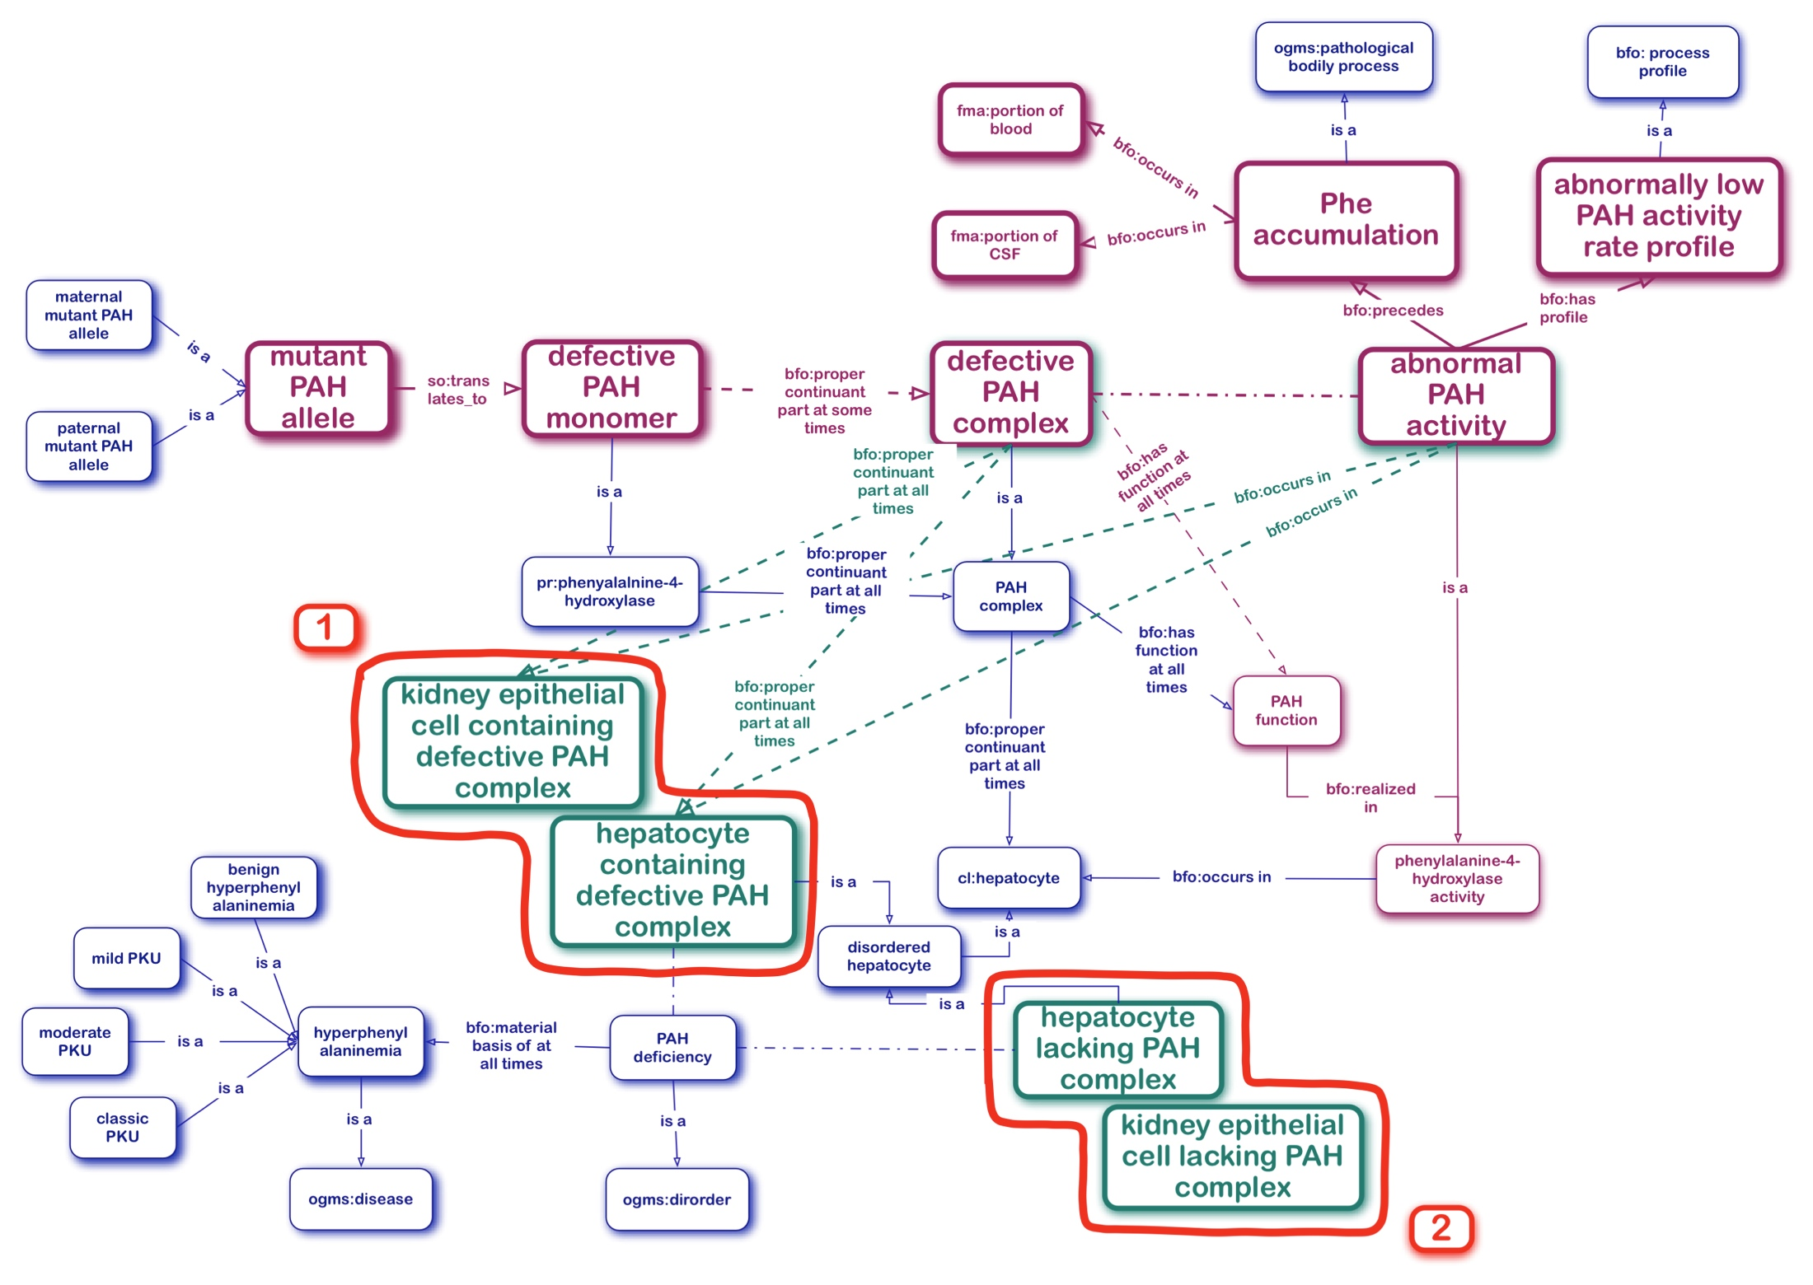
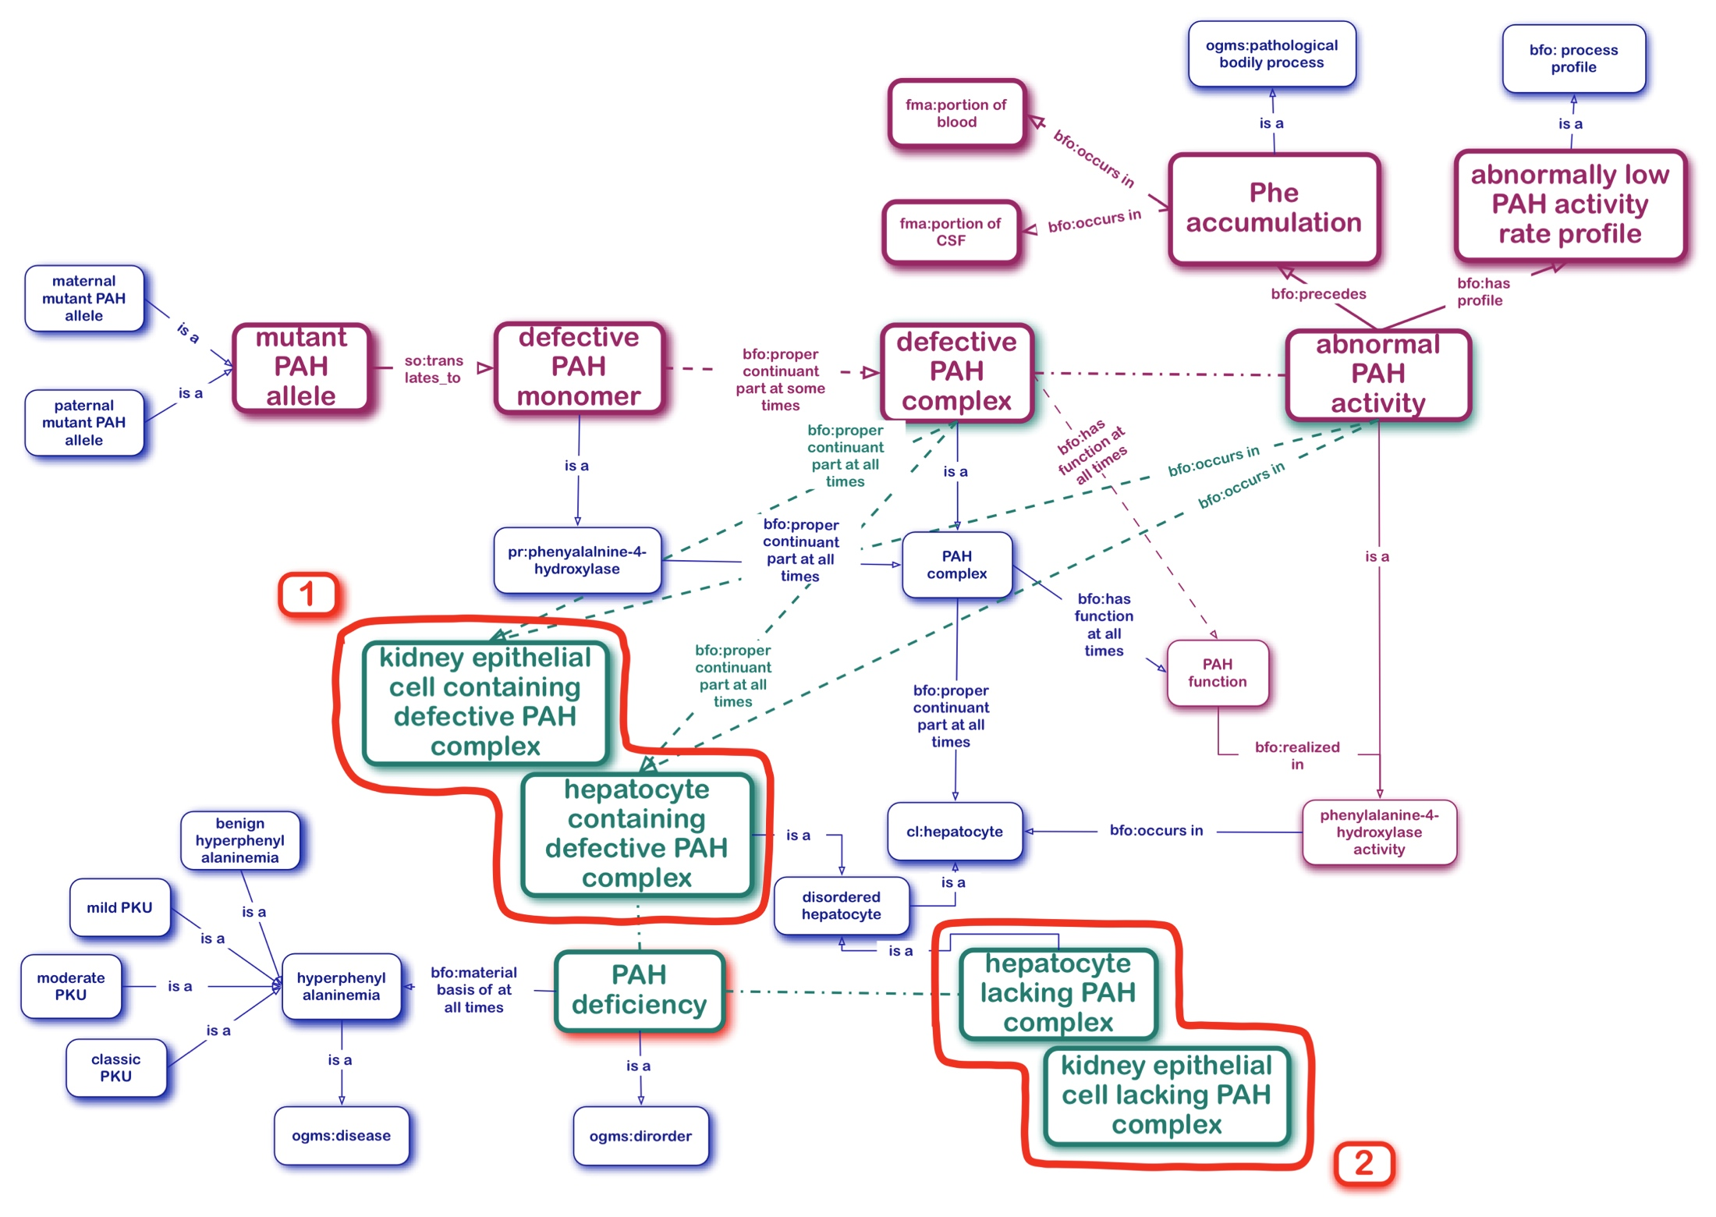
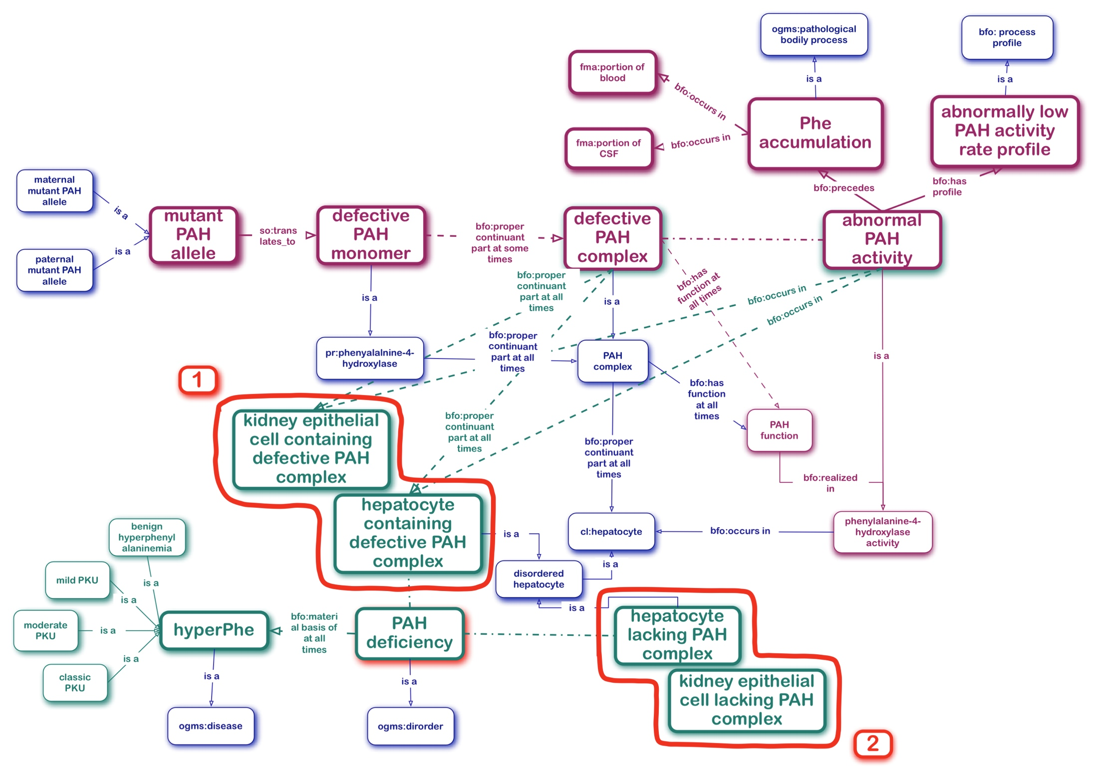
PAH Deficiency the Disorder and HyperPhe the Disease
OGMS
DISORDER =def. A material entity which is clinically abnormal
and a part of an extended organism.
Disorders are physical basis of disease.
DISEASE =def. A disposition
(i) to undergo pathological processes that
(ii) exists in an organism because of one or more disorders in that organism.
1
2

Slide 37
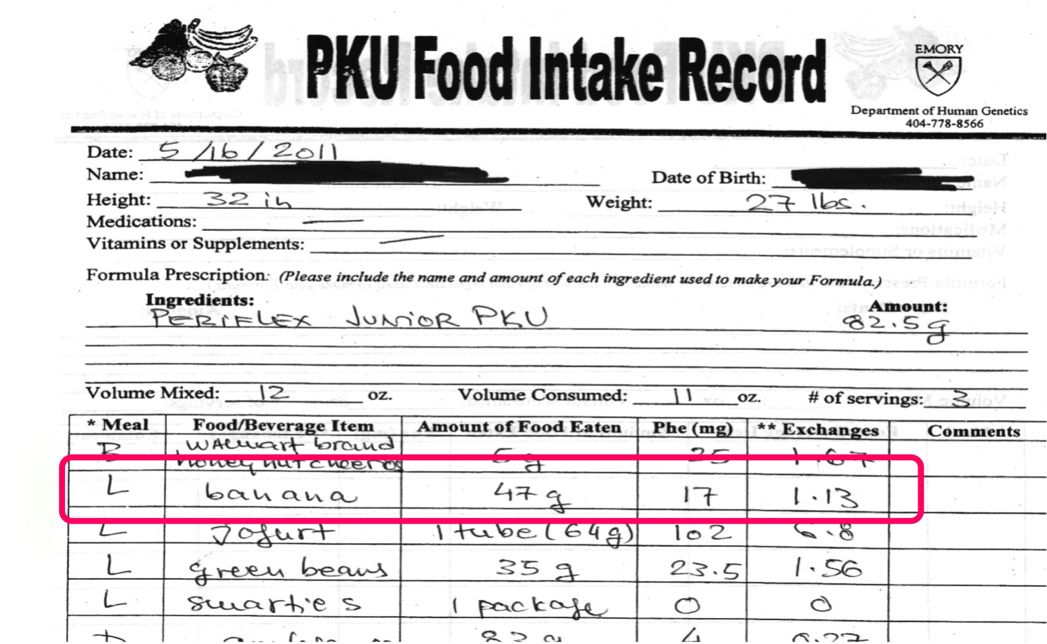
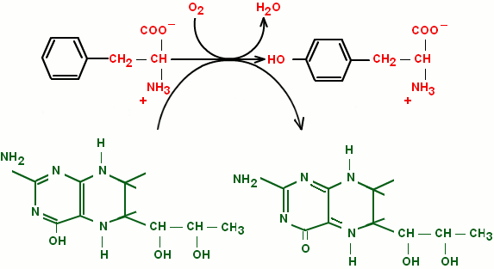
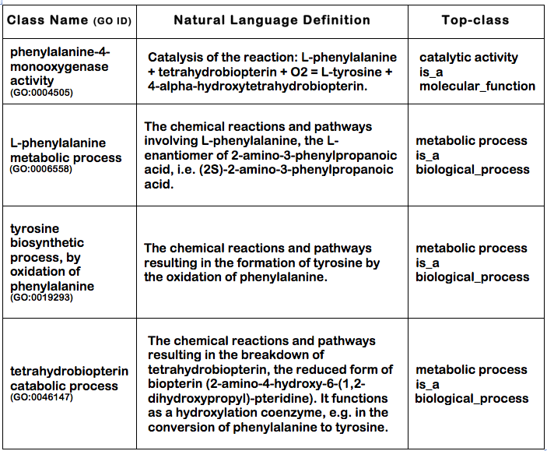
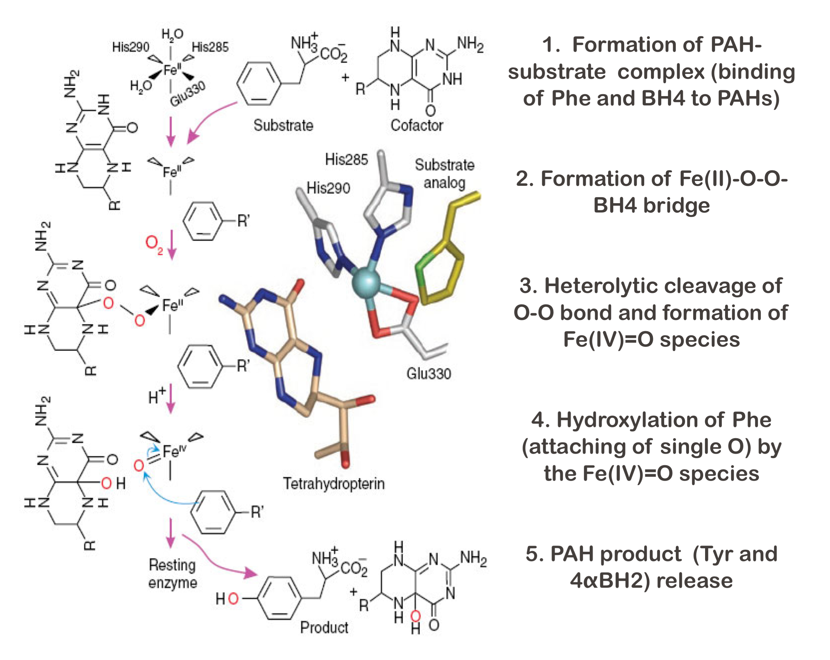
PAH Enzyme Activity Participants
- Why Bother?
Phe
•Dietary supplement/Therapy
•PAH enzyme product
•TAH enzyme substrate
Tyr
•PheOH/TyrOH/TrpOH enzyme product
•PCD enzyme substrate
BH4
4aOH-BH2
•SR/DHPR enzyme product
•PheOH/TyrOH/TrpOH enzyme cofactor
•Pharmacological chaperone (treatment option)
part_of

Slide 38
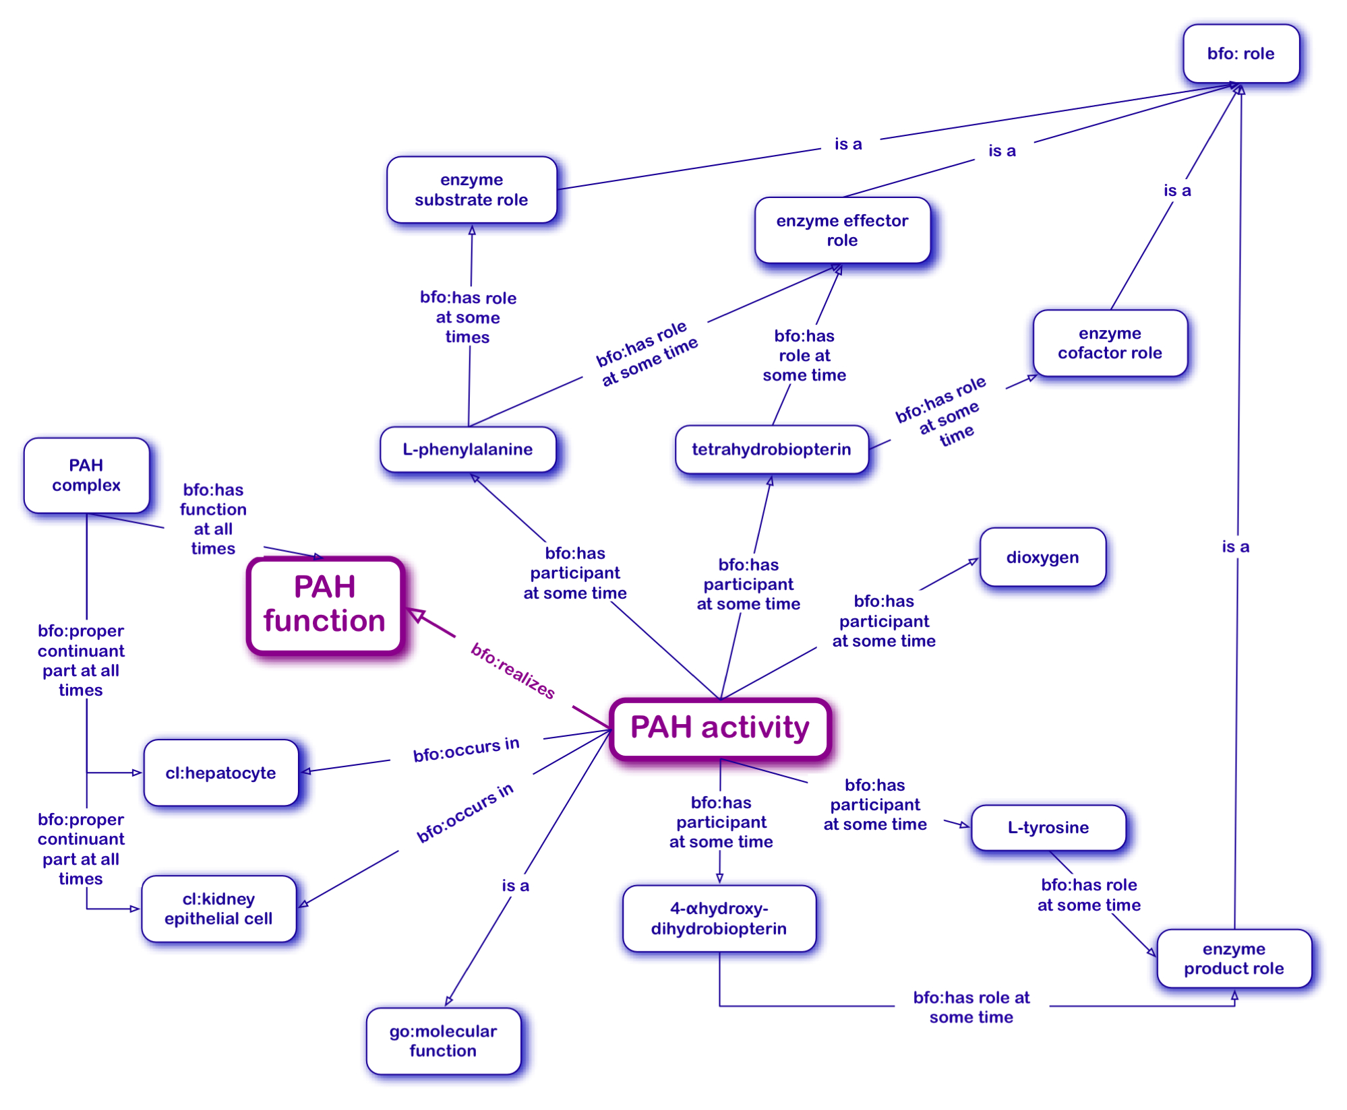
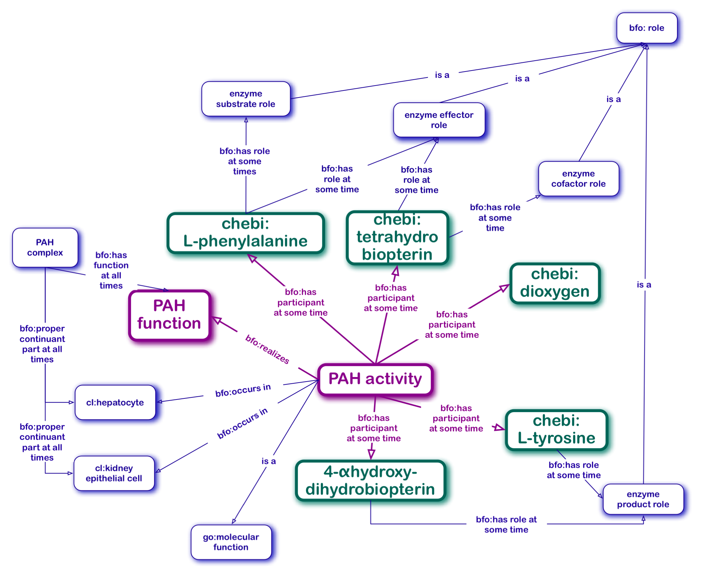
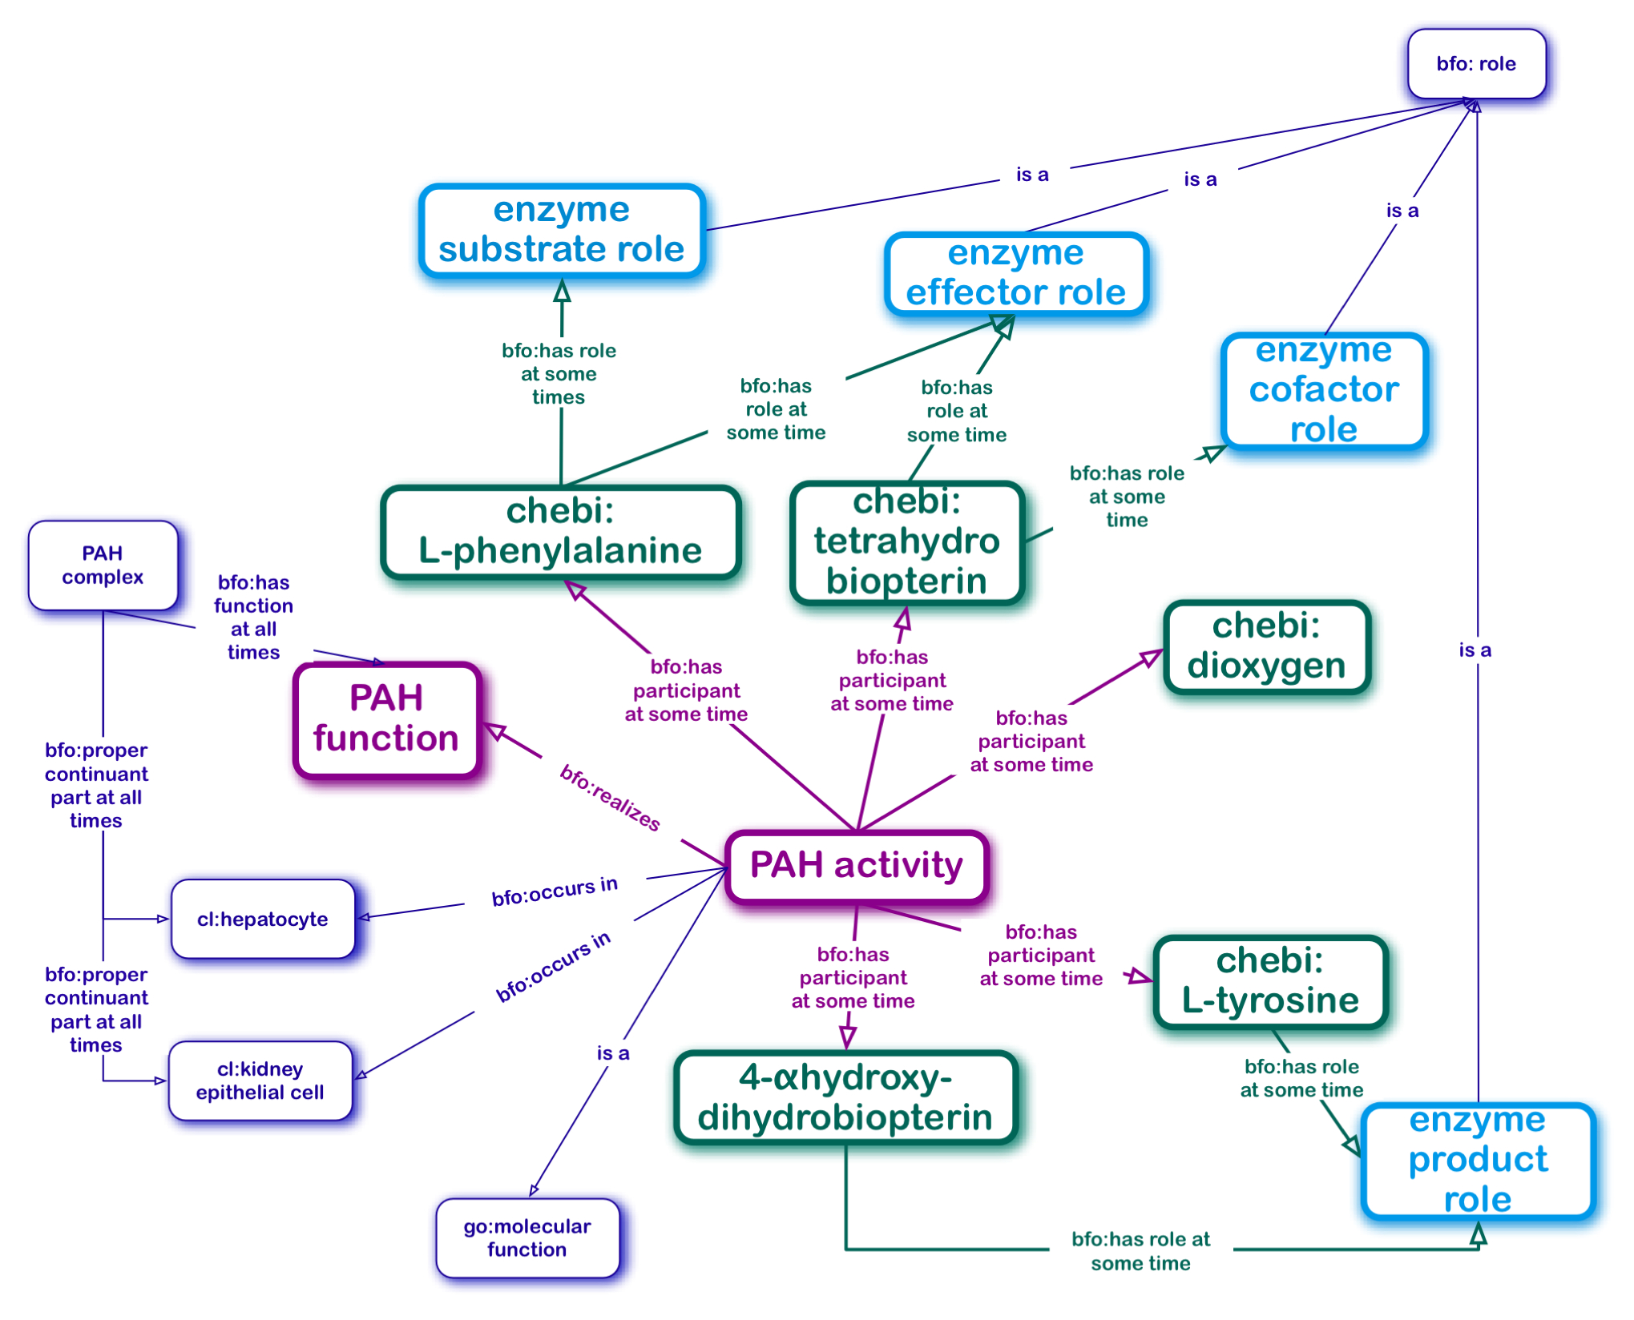
PAH Enzyme Activity Onto Model: Modified Situational Role Model
Enzymes are bearers of bfo:function
Phe
Tyr
PAH
BH4
4αOH-BH2
Other participants of enzymatic processes
are bearers of bfo:role

Slide 39
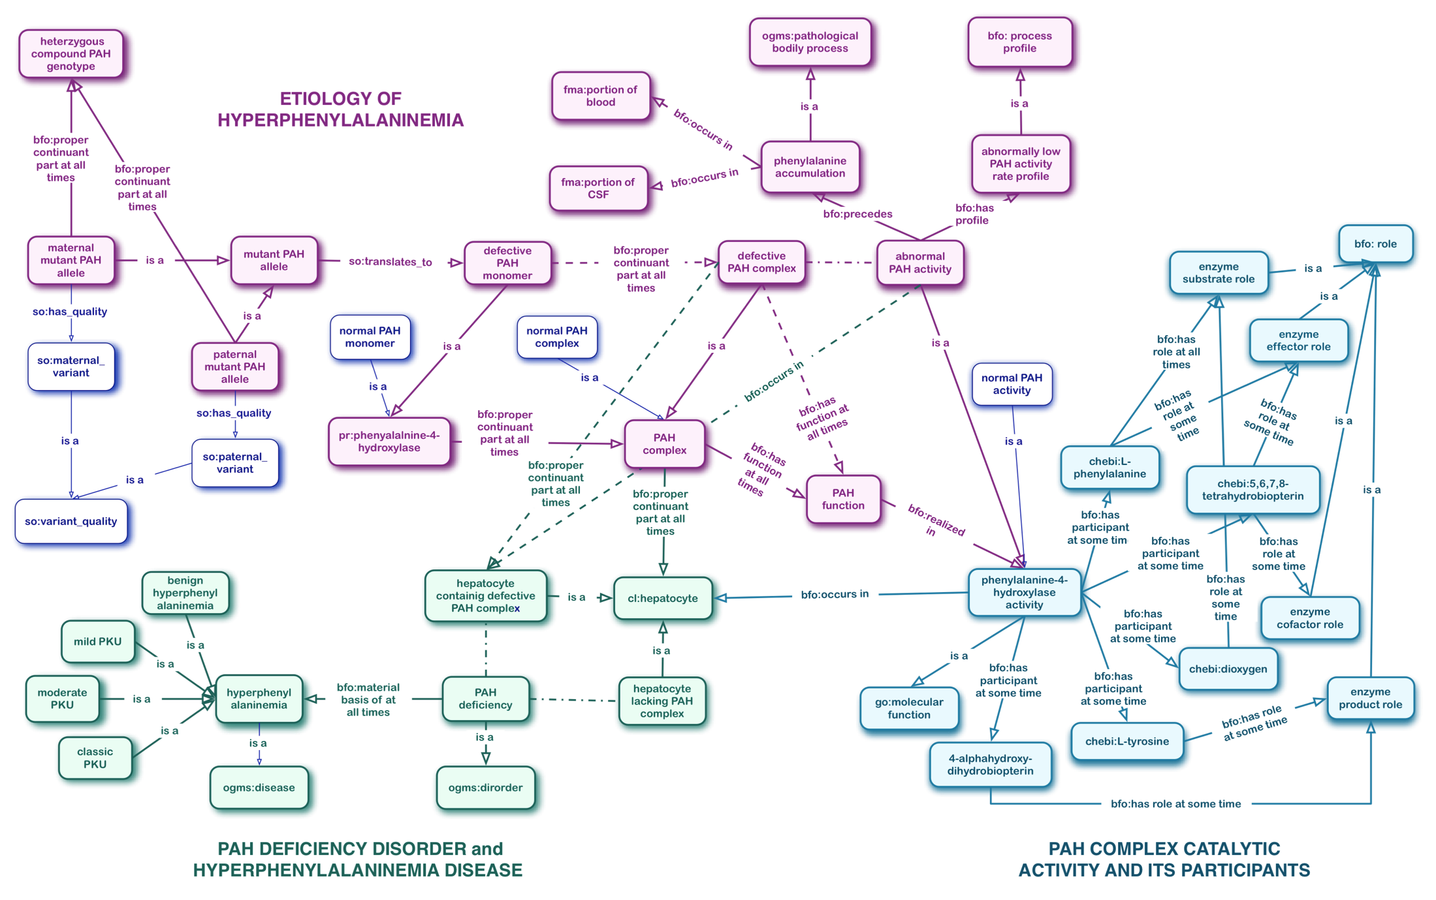
All Together Now: From Gene to Disease

Slide 40
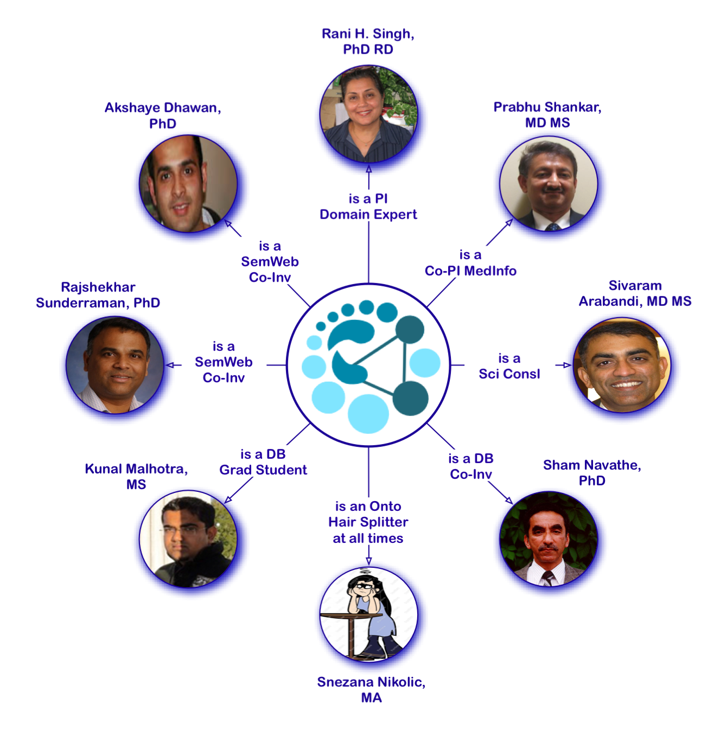
Acknowledgements
This work is partially supported by a 2009-10 HSI Seed Grant awarded by the Clinical Outcomes Research and Public Health (CORPH) Pilot Grants Program and by the Georgia Institute of Technology, the Children’s Healthcare of Atlanta and the Southeast NBS and Genetics Collaborative Grant awarded from the Maternal and Child Health Bureau,
HRSA Grant #U22MC10979.

Slide 41
Thank you!
https://nbsdc.org

Slide 46
Hyperphenyalalniemia, Phenylketonuria (PKU) and Phenylalanine Hydroxylase Deficiency (defs in the literature)
HYPERPHENYLALNINEMIA (HPA)
any of several inherited defects in the hydroxylation of phenylalanine...some are benign while others cause phenylketonuria... [Dorland's Medical Dictionary for Health Consumers ]
2. excess of phenylalanine in the blood. [Dorland's Medical Dictionary for Health Consumers ]
3. The presence of abnormally high blood levels of phenylalanine, ...associated with the heterozygous state of phenylketonuria,... [Farlex Partner Medical Dictionary ]
PHENYLKETONURIA (PKU)
1. Phenylketonuria (PKU) can be defined as a rare metabolic disorder caused by a deficiency in the production of the hepatic (liver) enzyme phenylalanine hydroxylase (PAH).... inherited, autosomal recessive disorder. It is the most common genetic disease ... [http://medical-dictionary.thefreedictionary.com/phenylketonuria]
2. The term phenylketonuria...and has remained the most widely used name for hyperphenylalaninemia (HPA) due to phenylalanine hydroxylase deficiency.
PHENYLALANINE HYDROXYLASE (PAH) DEFICINECY
...phenylalanine hydroxylase (PAH) deficiency is a subgroup of hyperphenyalalninemia (HPA) caused by specific mutations in the PAH gene...The spectrum of HPAs caused by PAH deficiency...

Slide 47
Inherited Metabolic Diseases (IMDs) a.k.a Inborn Errors of Metabolism (IEMs)
 Rare diseases
 Etiology - Similar
Enzyme protomer
gene mutation
Misfolded or missing
enzyme protomer
Dysfunctional or missing
enzyme complex
Toxic accumulation
of enzyme substrate
and other
Lack of enzyme
product
CNS malnurishment
and damage
Developmetal delay
(psycho-
motog/cognitive)
Long-term or Life-long Treatment
Restrict the dietary intake of foods containing
the enzyme substrate (e.g., target amino/fatty/organic acid)
2. Maintain the adequate intakes of all nutrients
to ensure maximally normal growth and development

Slide 48


Phenylalanine Hydroxylase (PAH)
PAH
EC1.14.16.1

Slide 49

PAH Catalytic Activity
Phe
Tyr
part_of
BH4
4aOH-BH2

